Slide 1
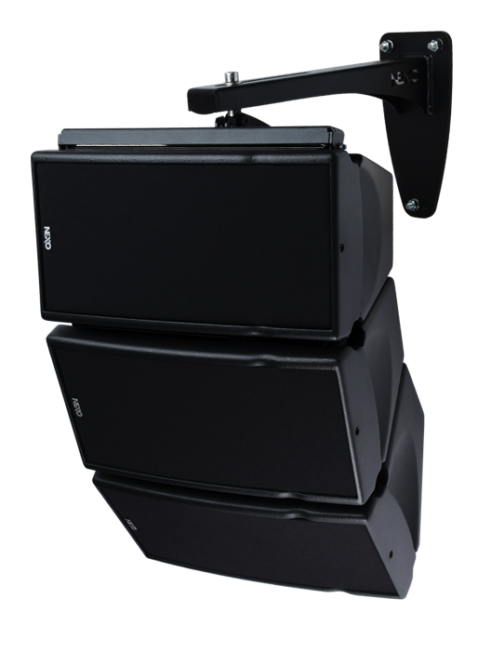


GEO M6 Compact Sound Reinforcement System

Slide 2
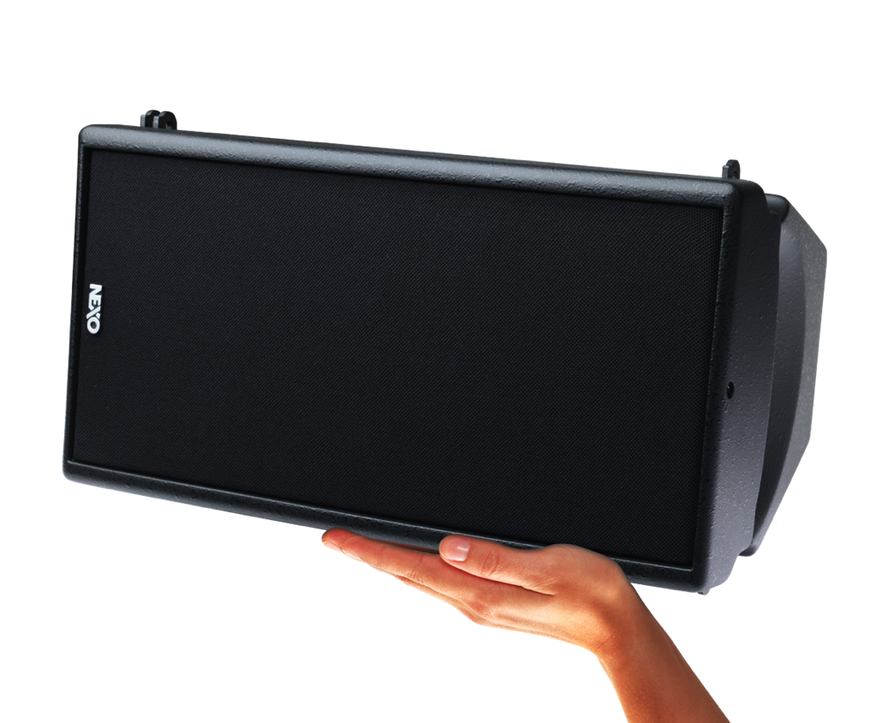
GEO M6 consists of 2 identically-sized compact modules

Slide 3
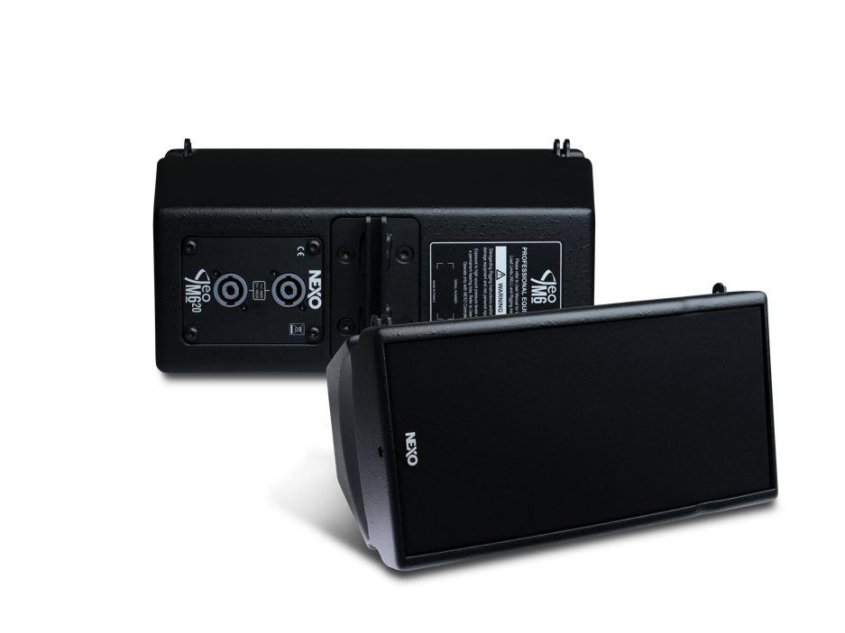
GEO M620 Full-Range
• 1 x 6.5 inch LF/MF driver
• 1 x HF compression driver
• Frequency response 80Hz-19kHz
• 127dB peak SPL
• 191 x 373 x 260mm
• 9.7kg
• HF dispersion 80 or 120˚ horizontal (CCD)

Slide 4
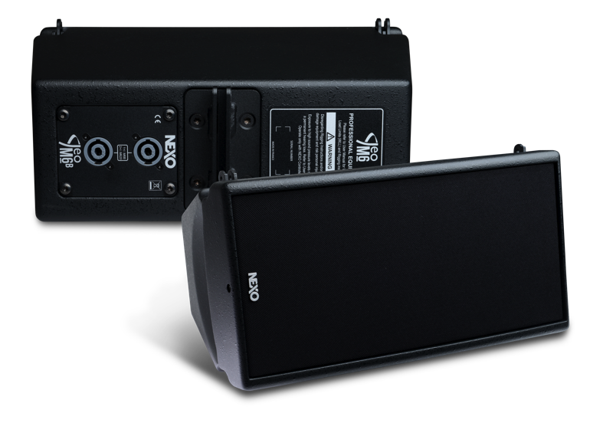
GEO M6B Bass Extension
• 1 x 6.5 inch LF/MF driver
• 1 x HF compression driver
• Frequency response 80Hz-19kHz
• 127dB peak SPL
• 191 x 373 x 260mm
• 9.7kg
• HF dispersion 80 or 120˚ horizontal (CCD)

Slide 5
Lightweight polyurethane composite cabinets

Slide 6
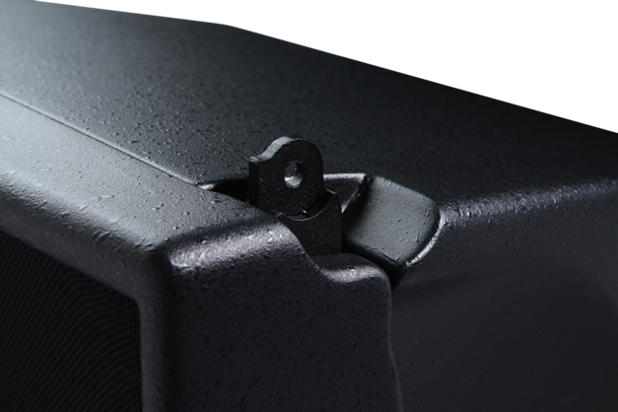
3-point rigging system hidden in cabinet

Slide 7
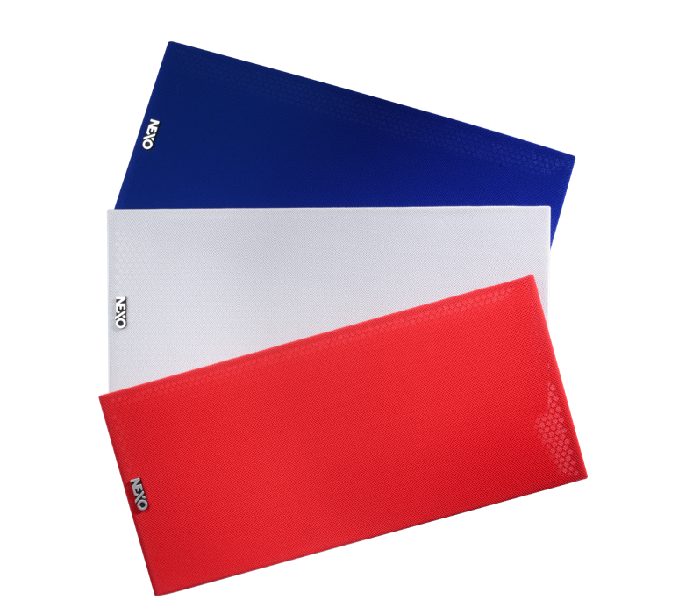
Cabinets, grilles and accessories can be specified in any RAL colour

Slide 8
Flexibility without compromise

Slide 9
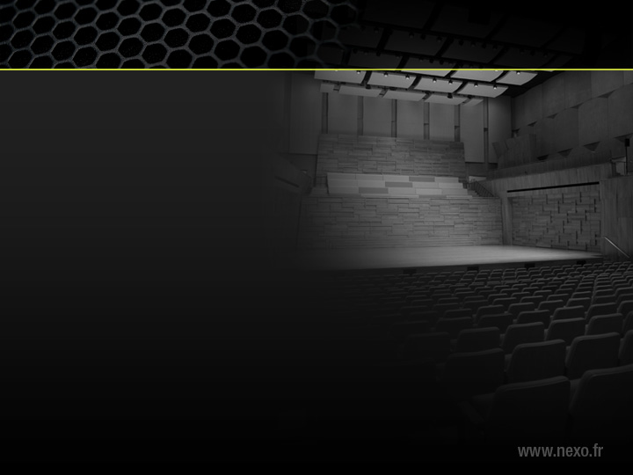
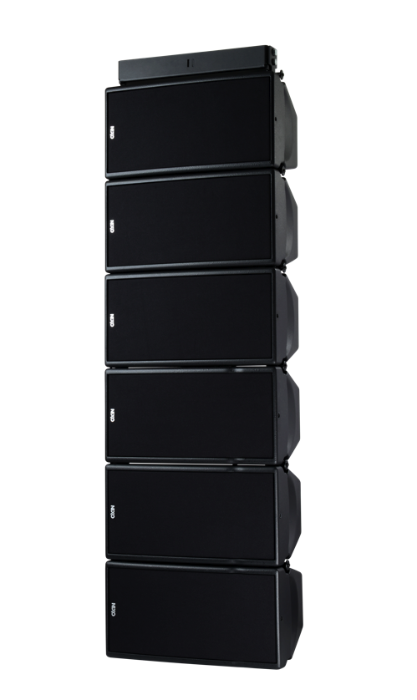


In theatres and conference halls main and bass extension cabinets can be flown in the same array

Slide 10

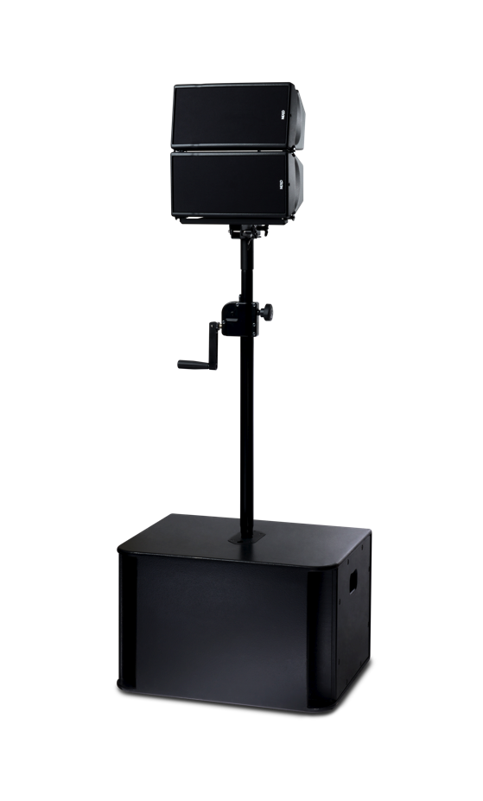
For corporate applications cabinets can be pole-mounted on NEXO subs

Slide 11

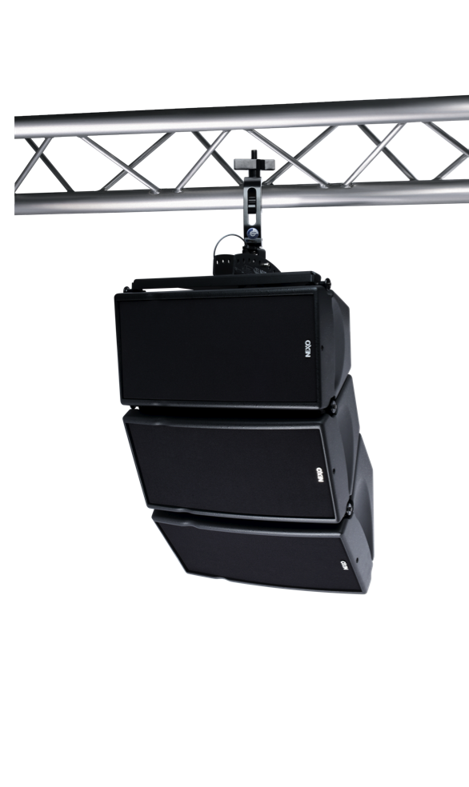
Small full-range clusters can be quickly flown for live events

Slide 12

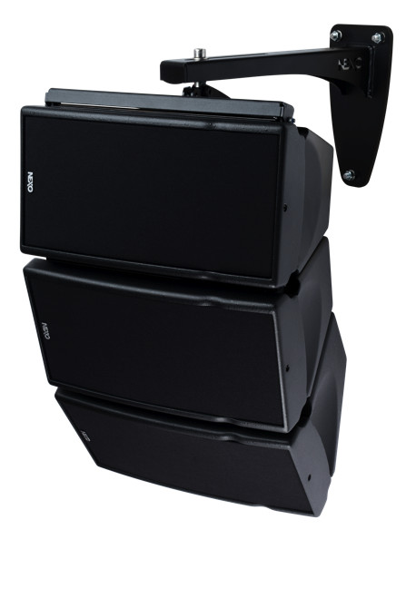

Or permanently installed in public spaces

Slide 13
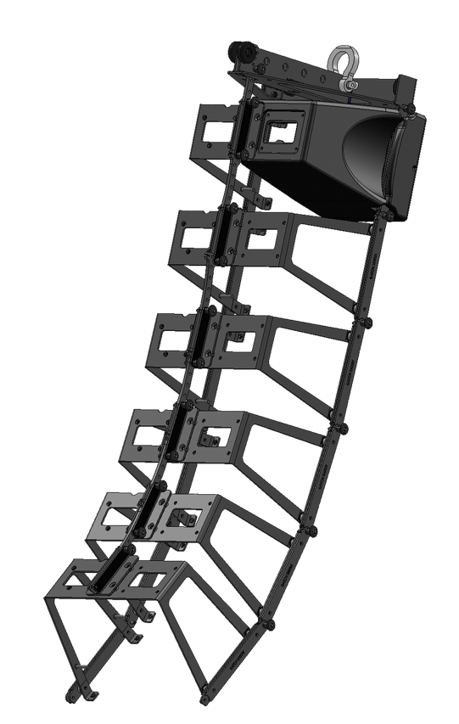
Introducing the
NEXOSkeleton™ Rigging System

Slide 14

Fully TÜV certified

Slide 15
Advanced NEXO concert line array technology brings high performance to a compact system

Slide 16
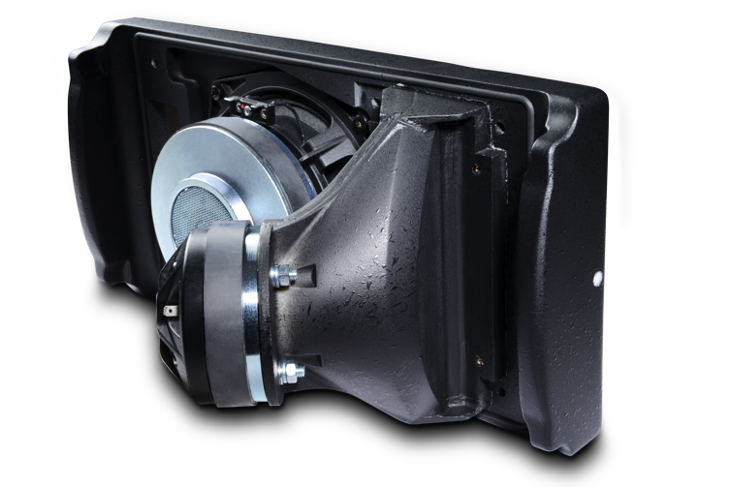
NEXO Hyperbolic Reflective Wavesource

Slide 17
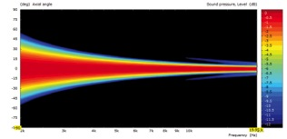

NEXO Hyperbolic Reflective Wavesource
Ideal theoretical response
Actual measured response

Slide 18
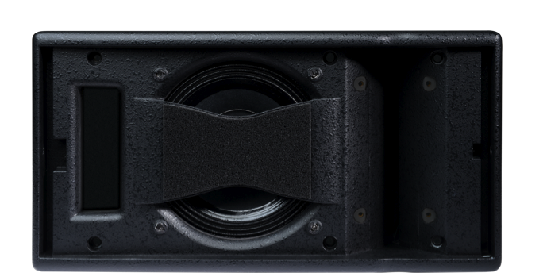
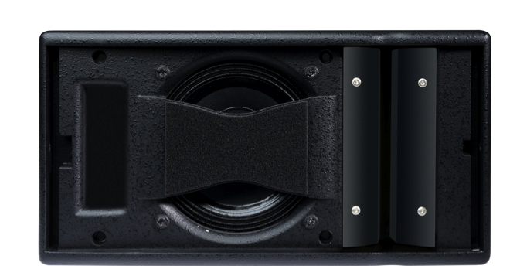

NEXO Waveguide Flanges

Slide 19
NEXO Waveguide Flanges
Standard 80º horizontal coverage
120º horizontal coverage

Slide 20
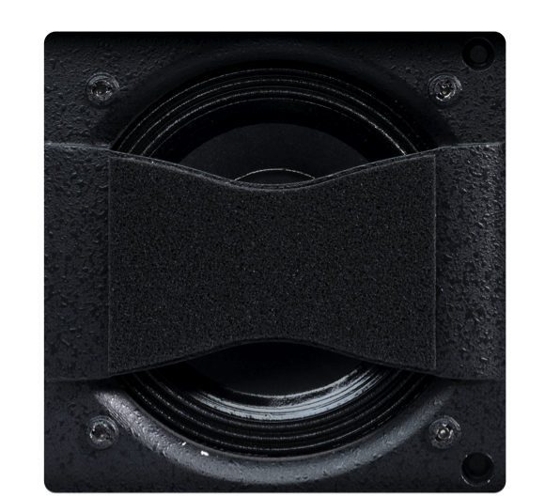

NEXO Directivity Phase Device for coherent coupling

Slide 21
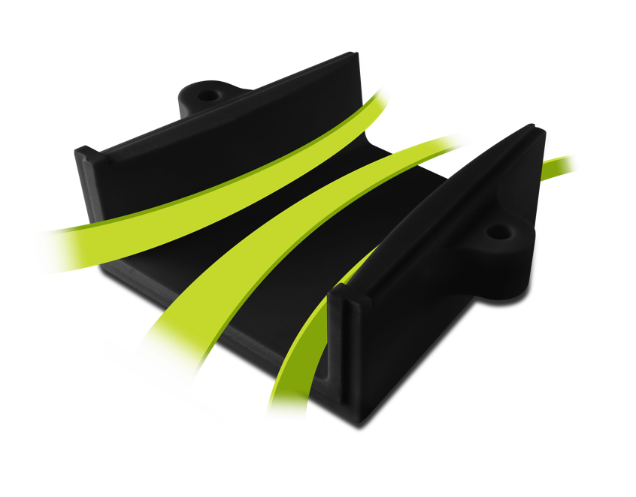
Port tube profiling for increased LF efficiency and linearity at high power

Slide 22
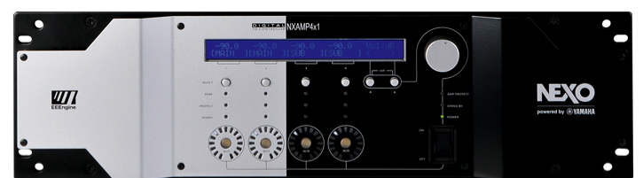
Just one NXAMP4X1 is all it takes

Slide 23
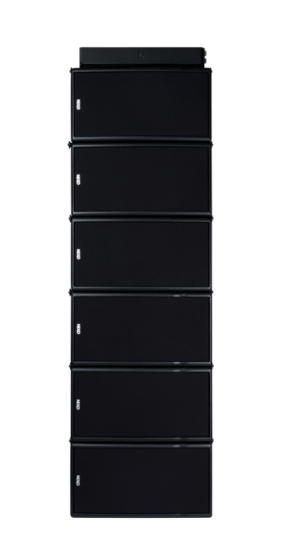


to power a 6 box per side flown system

Slide 24
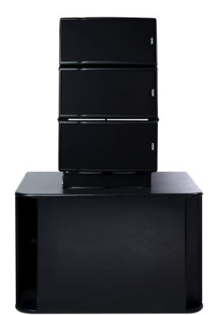

to power two powerful groundstacks using LS600 subs

Slide 25
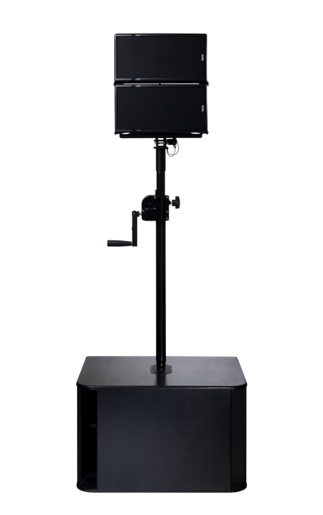
to power a pair of pole mounted systems using LS600 subs

Slide 26

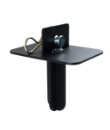

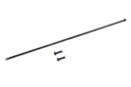
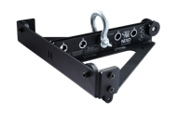
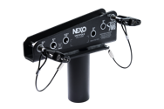


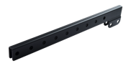
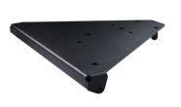
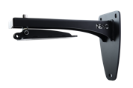
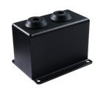
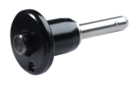
Full range of accessories
﻿• Pole-mount adaptor for stacking operation
• Angle setting plate for 3-cabinet clusters (hanging or pole mounted)
• Cabinet linking kit (fixed installations)
• Mobile bumper (12 cabinets maximum)
• Pole mount top / tilt plate
• Truss clamp
• Truss clamp
• Extension bar for extreme tilt applications
• Light bumper for 3-cabinet (max) applications
• Wall mount for 3-cabinet (max) applications
• IP protection cover for outdoor use
• Quick release pin

Slide 27
GEO M6
Advanced NEXO line array technology
High performance in a compact system

