Slide 1
Installation
Solutions

Slide 2
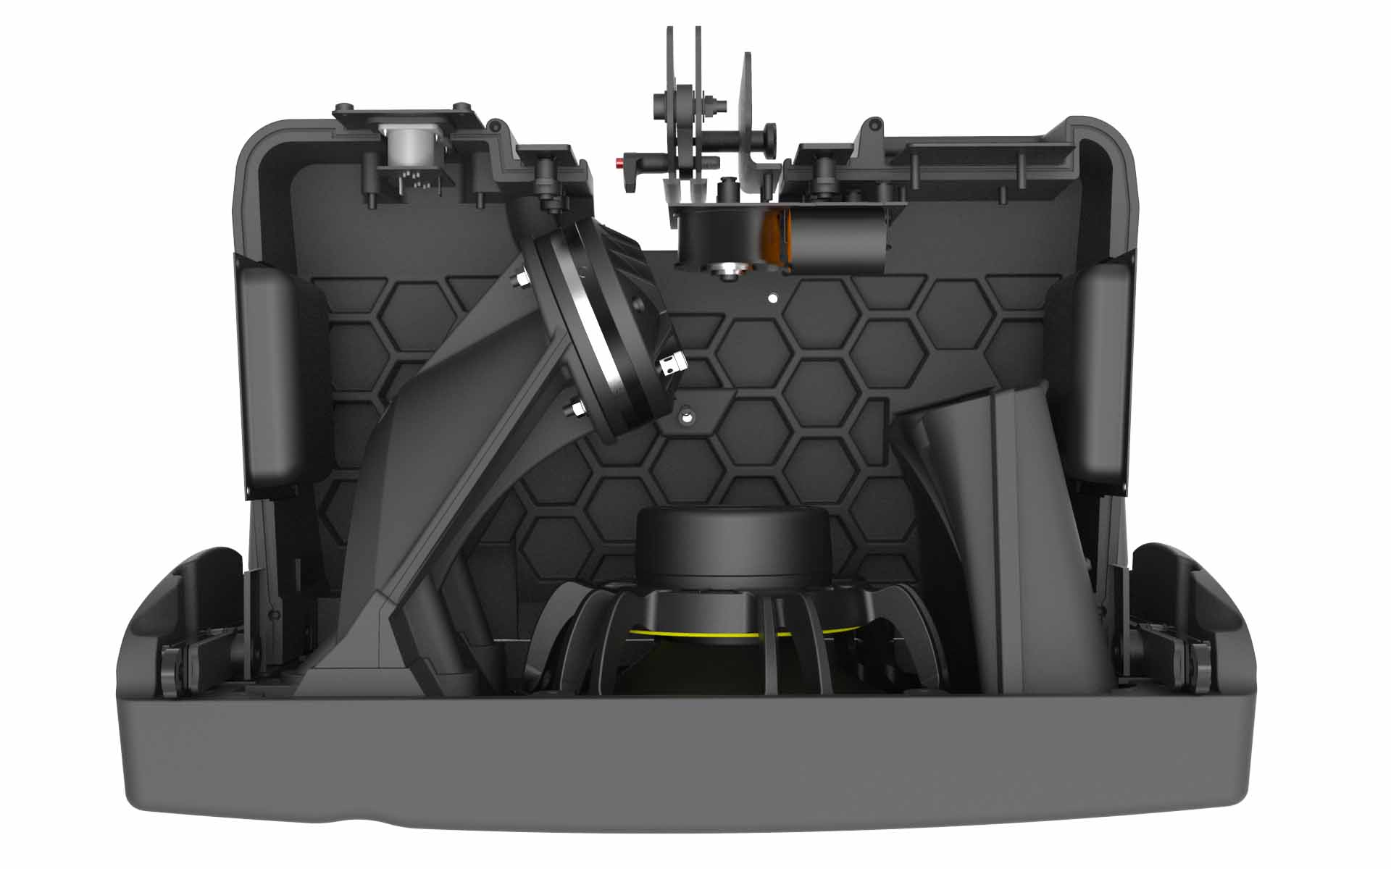
Thinking.
Inside the box.
At an ultra-modern campus near Paris, NEXO takes an integrated approach to loudspeaker system design, incorporating a number of patented technologies to deliver exceptional performance in a range of applications.
Hyperbolic Reflector Waveguide (HRW)
The groundbreaking NEXO GEO M10:
Thinking. Inside the box.
Phase Directivity Device (PDD)
Configurable Directivity Device (CDD)

Slide 3
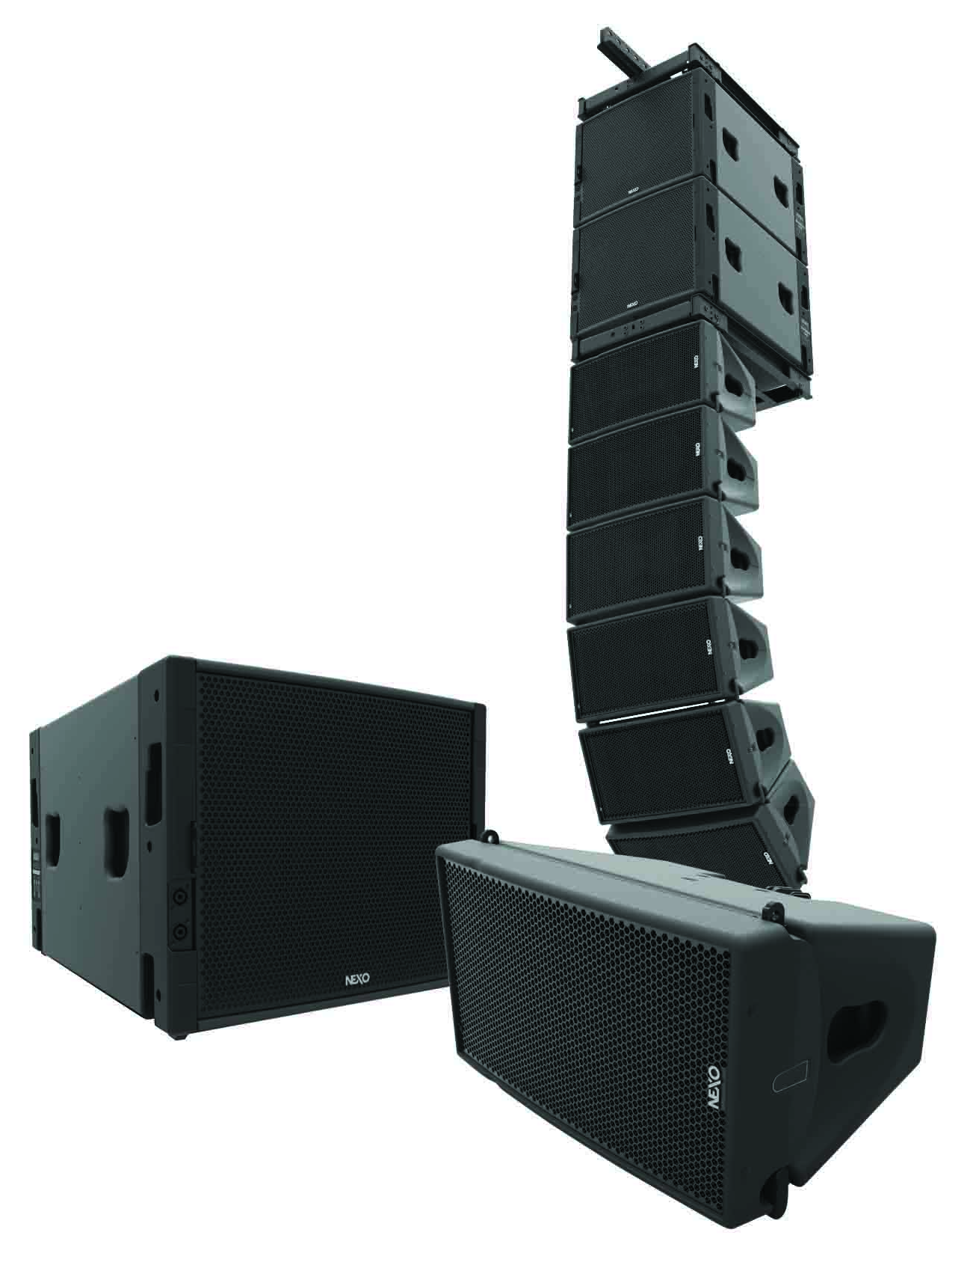
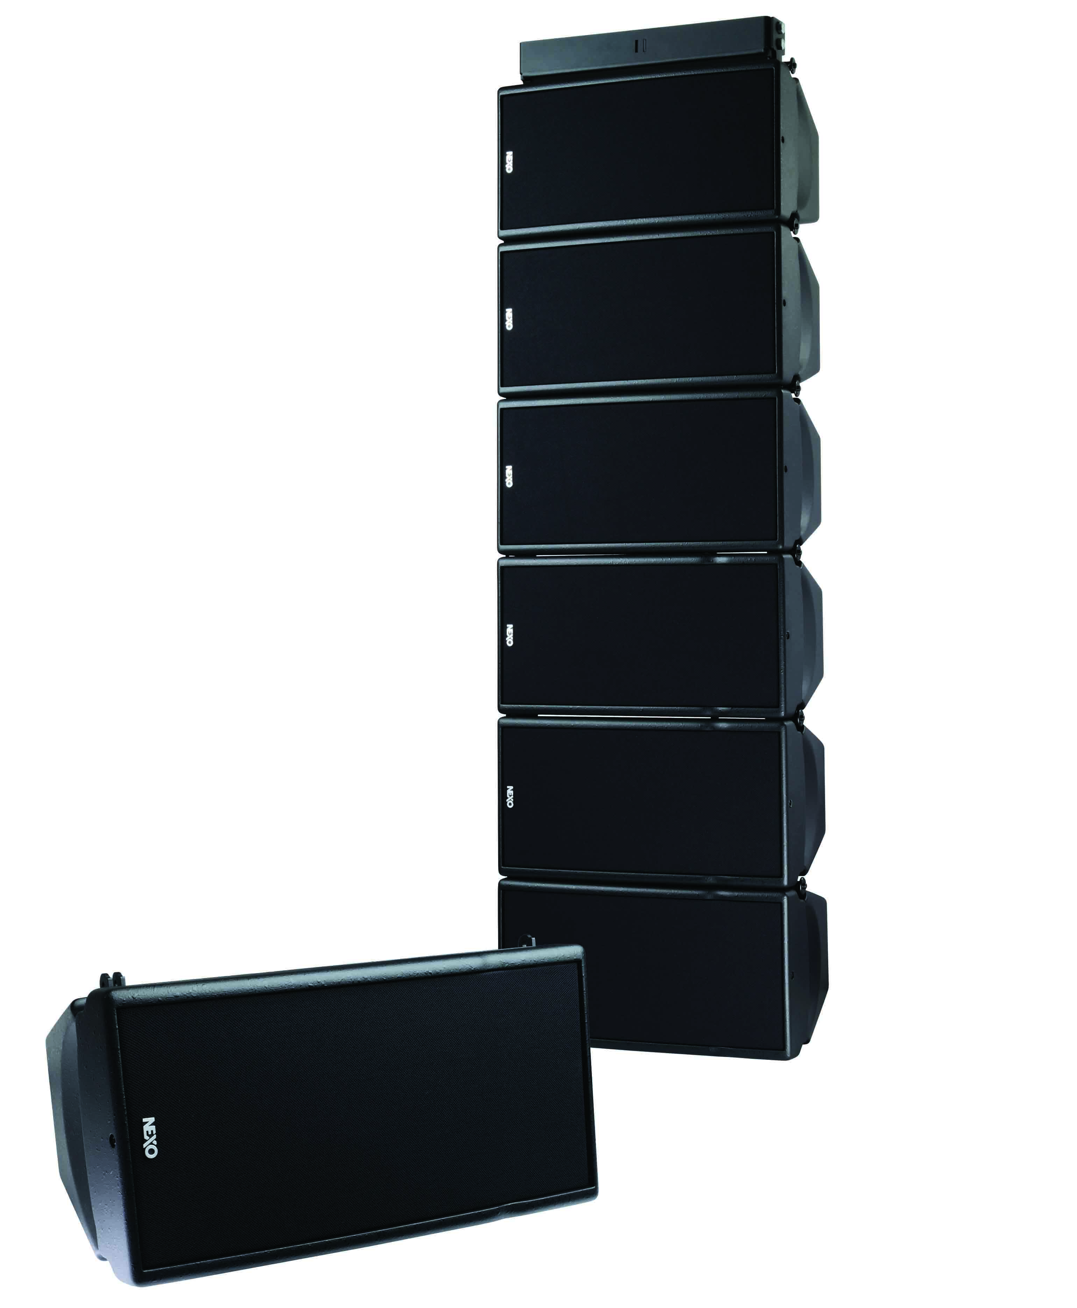
The perfect system
For every venue
From the ultra-compact ID Series to the mighty STM, NEXO loudspeaker systems provide designers and installers with the ultimate toolkit from which configure a high-performance sound reinforcement solution for applications of every size and scale. All NEXO systems can be custom finished in any RAL paint colour.
Compact Sound Systems
GEO M10
GEO M6
ID Series

Slide 4
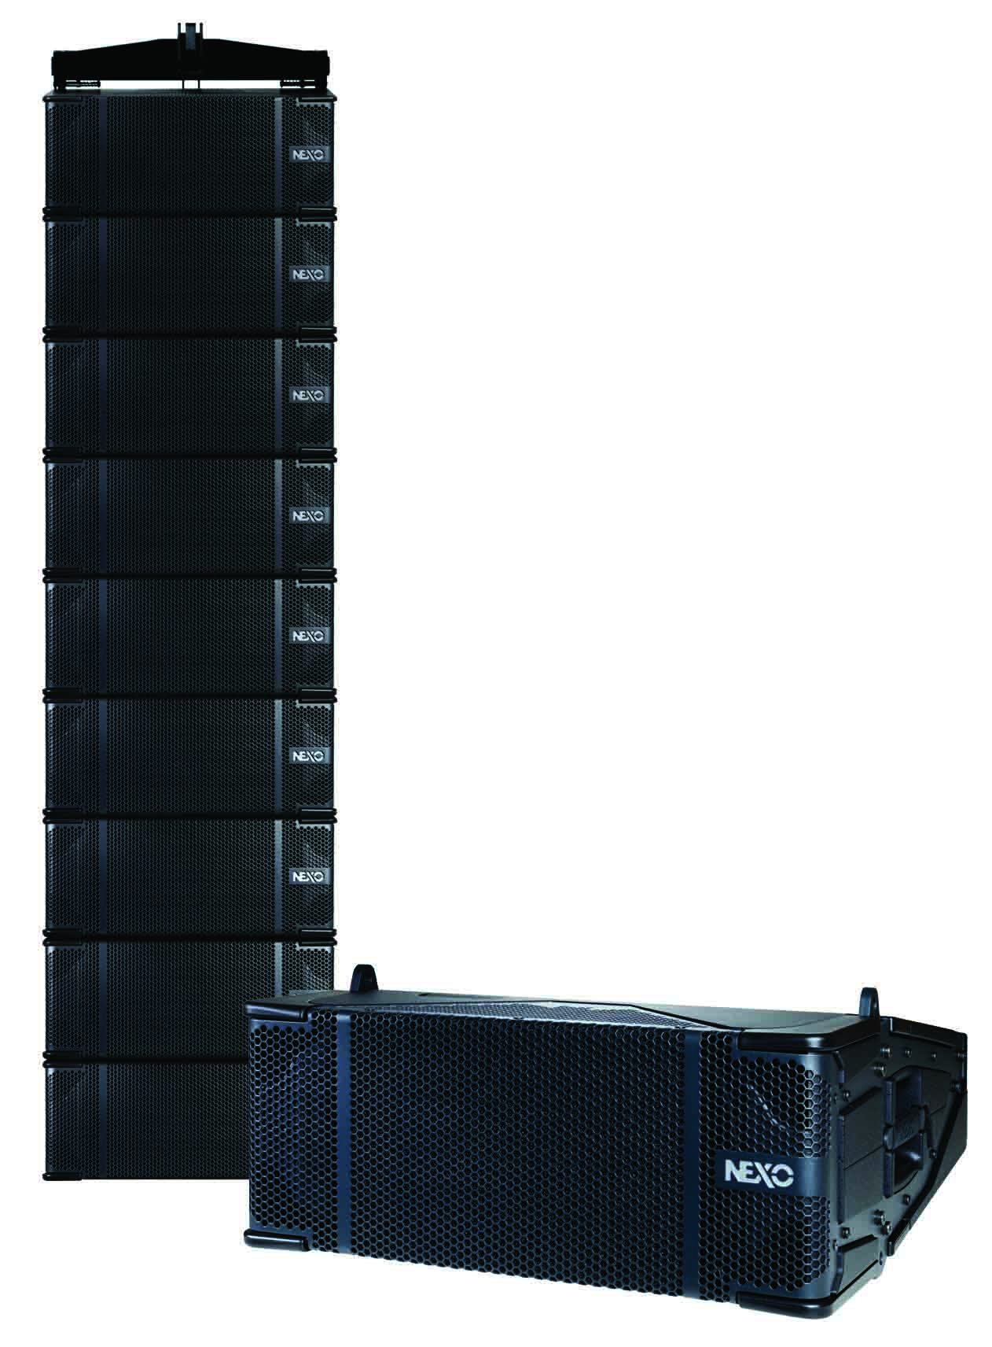
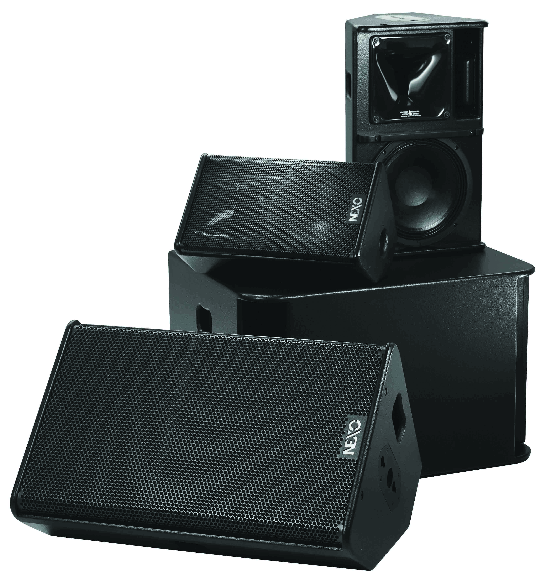
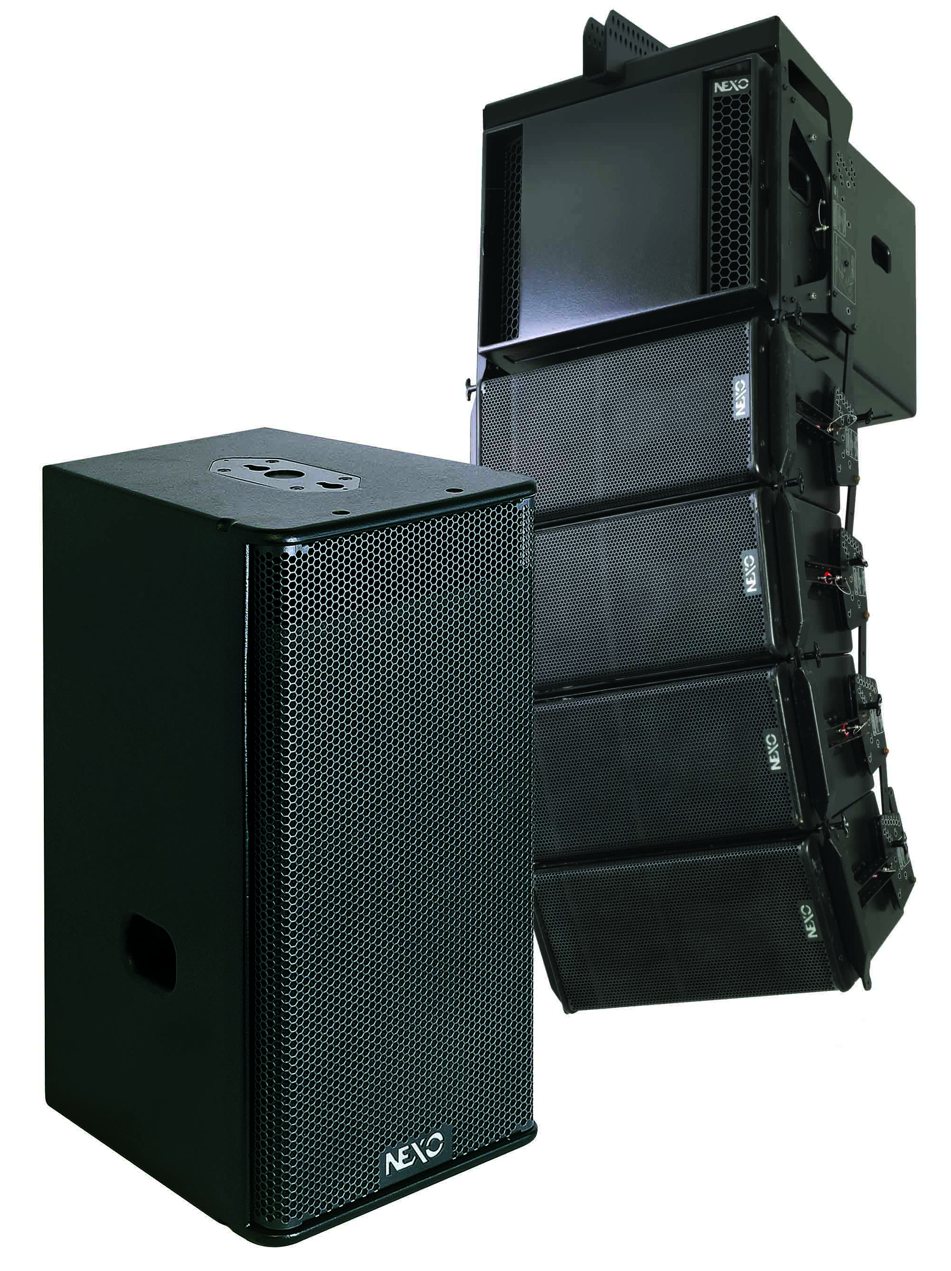
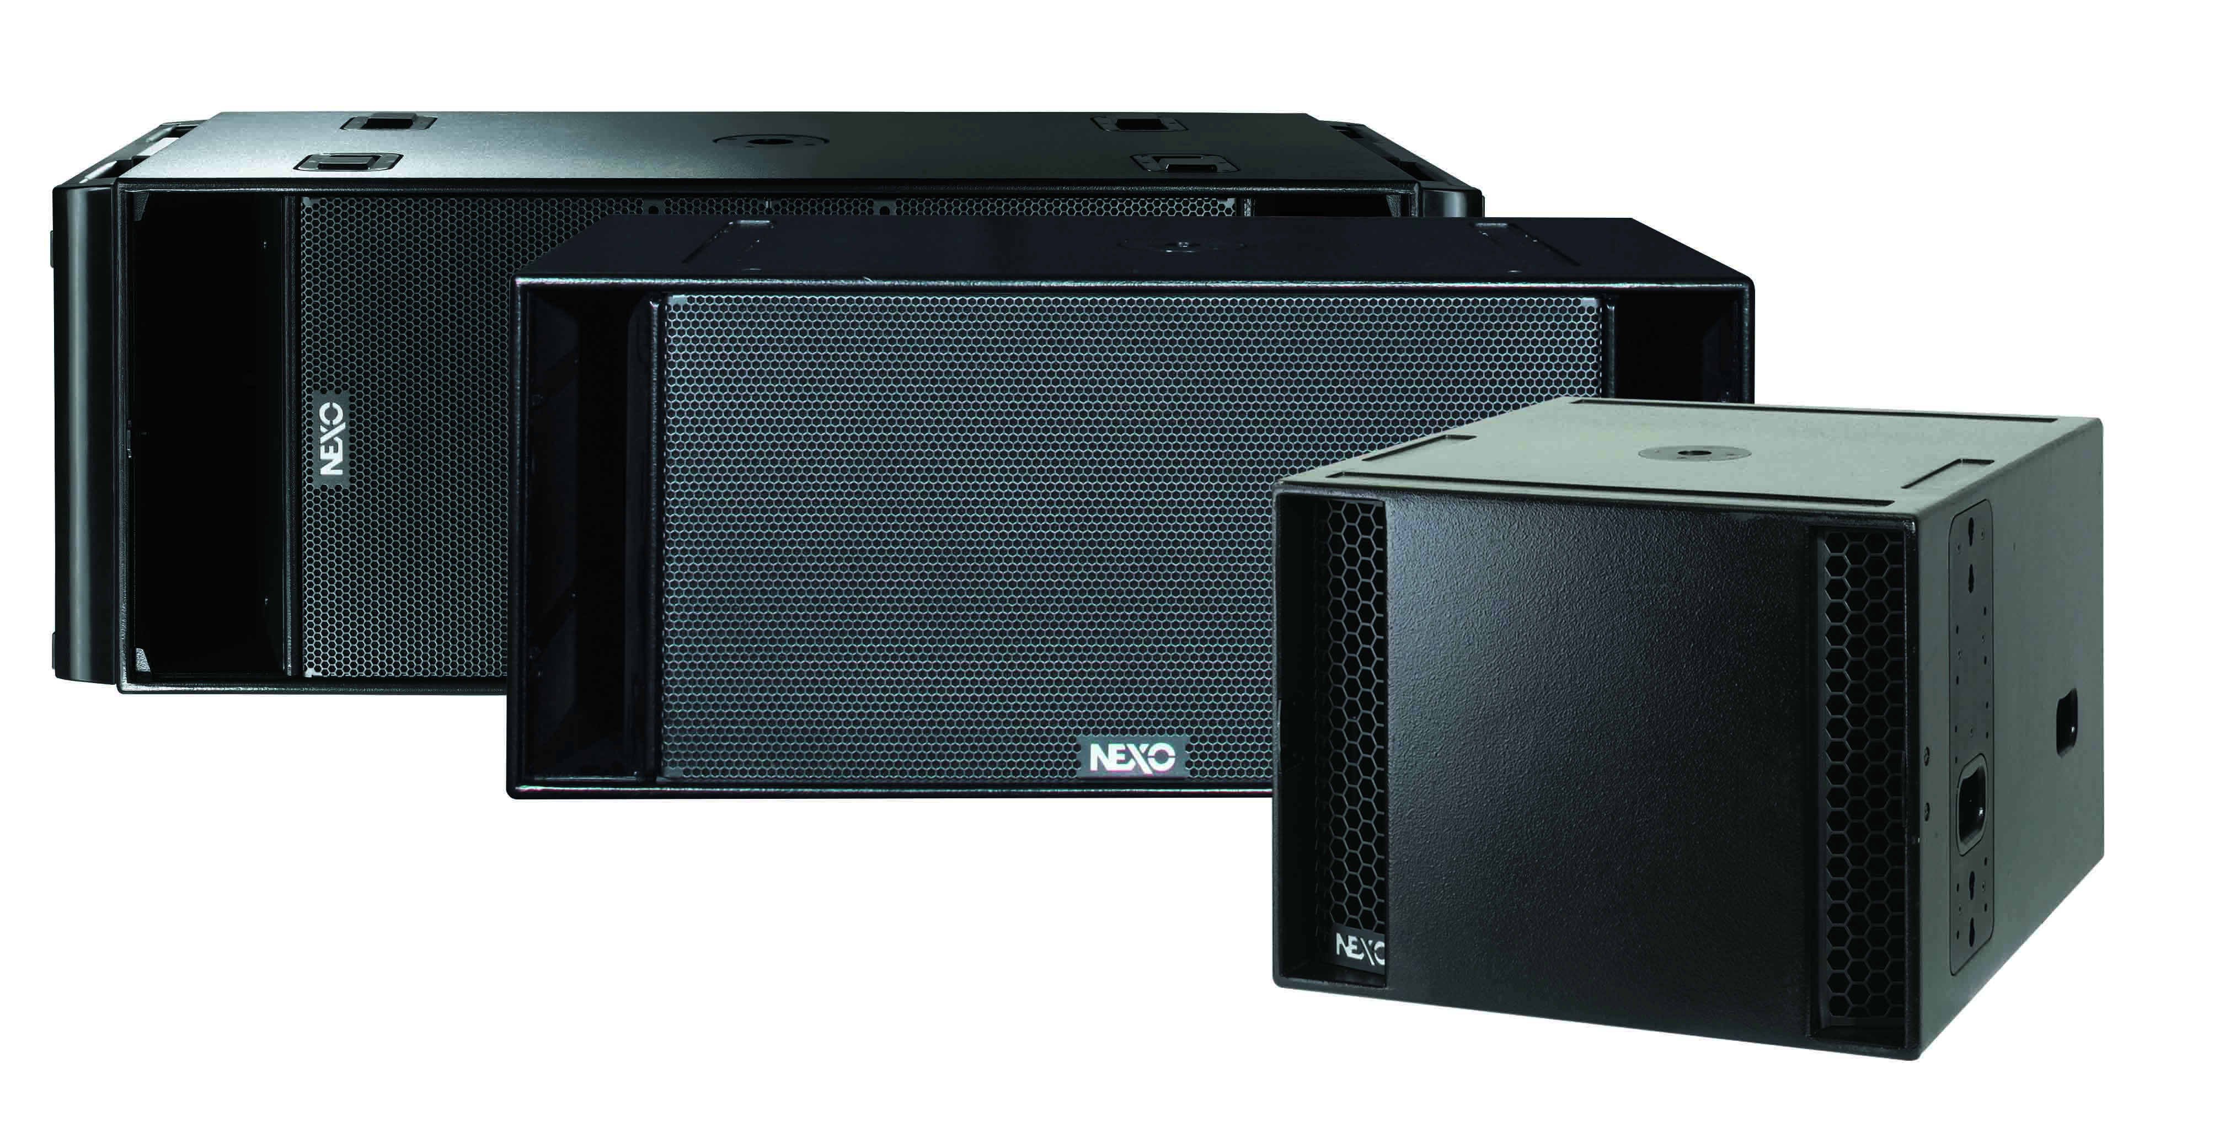
PS Series
STM
3 scalable systems.
Can be easily configured for a variety of applications.
The most powerful of the NEXO systems.
4 compact and proportionally-sized Main, Bass, Sub and Omni modules.
GEO S12
Subs
Advanced vertical / horizontal array design.
Elegant sound reinforcement solutions for a variety of applications.
LS18 and RS subs : designed to extend low-frequency performance in particular applications.

Slide 5
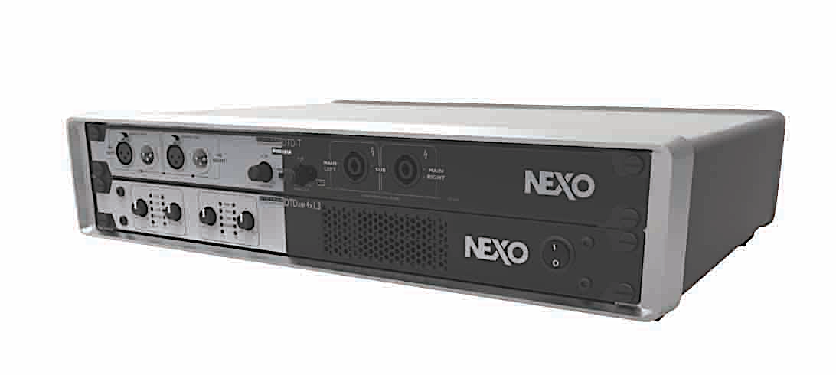
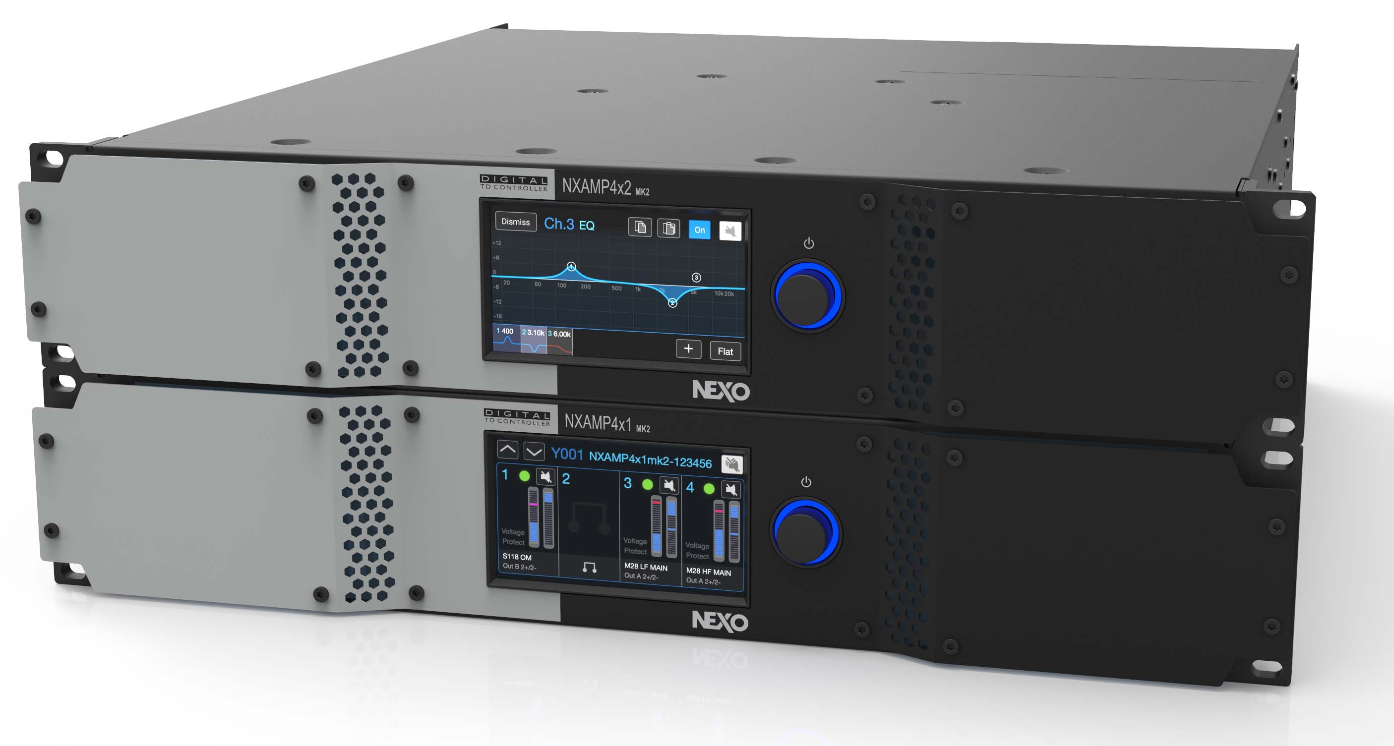
Power & Processing
NEXO’s range of powered controllers combines high performance, 4-channel amplification with advanced, preset DSP control to provide compact, elegant and easy-to-configure power solutions for NEXO installations.
DTD/DTDAMP
DTDAMP
4 x 700 Watts and 4 x 1300 Watts.
Ideal for powering fixed installations of NEXO ID and PS Series systems.
DTD
Delivers advanced speaker control processing taken from the NEXO NXAMP.
Sophisticated control over crossover, EQ and time-alignment along with speaker protection.
NXAMPMK2
4 x 1300 Watts and 4 x 2500 Watts versions.
Perfect, light weight, ‘Plug & Play’ power and control solution for larger NEXO loudspeaker systems.

Slide 6
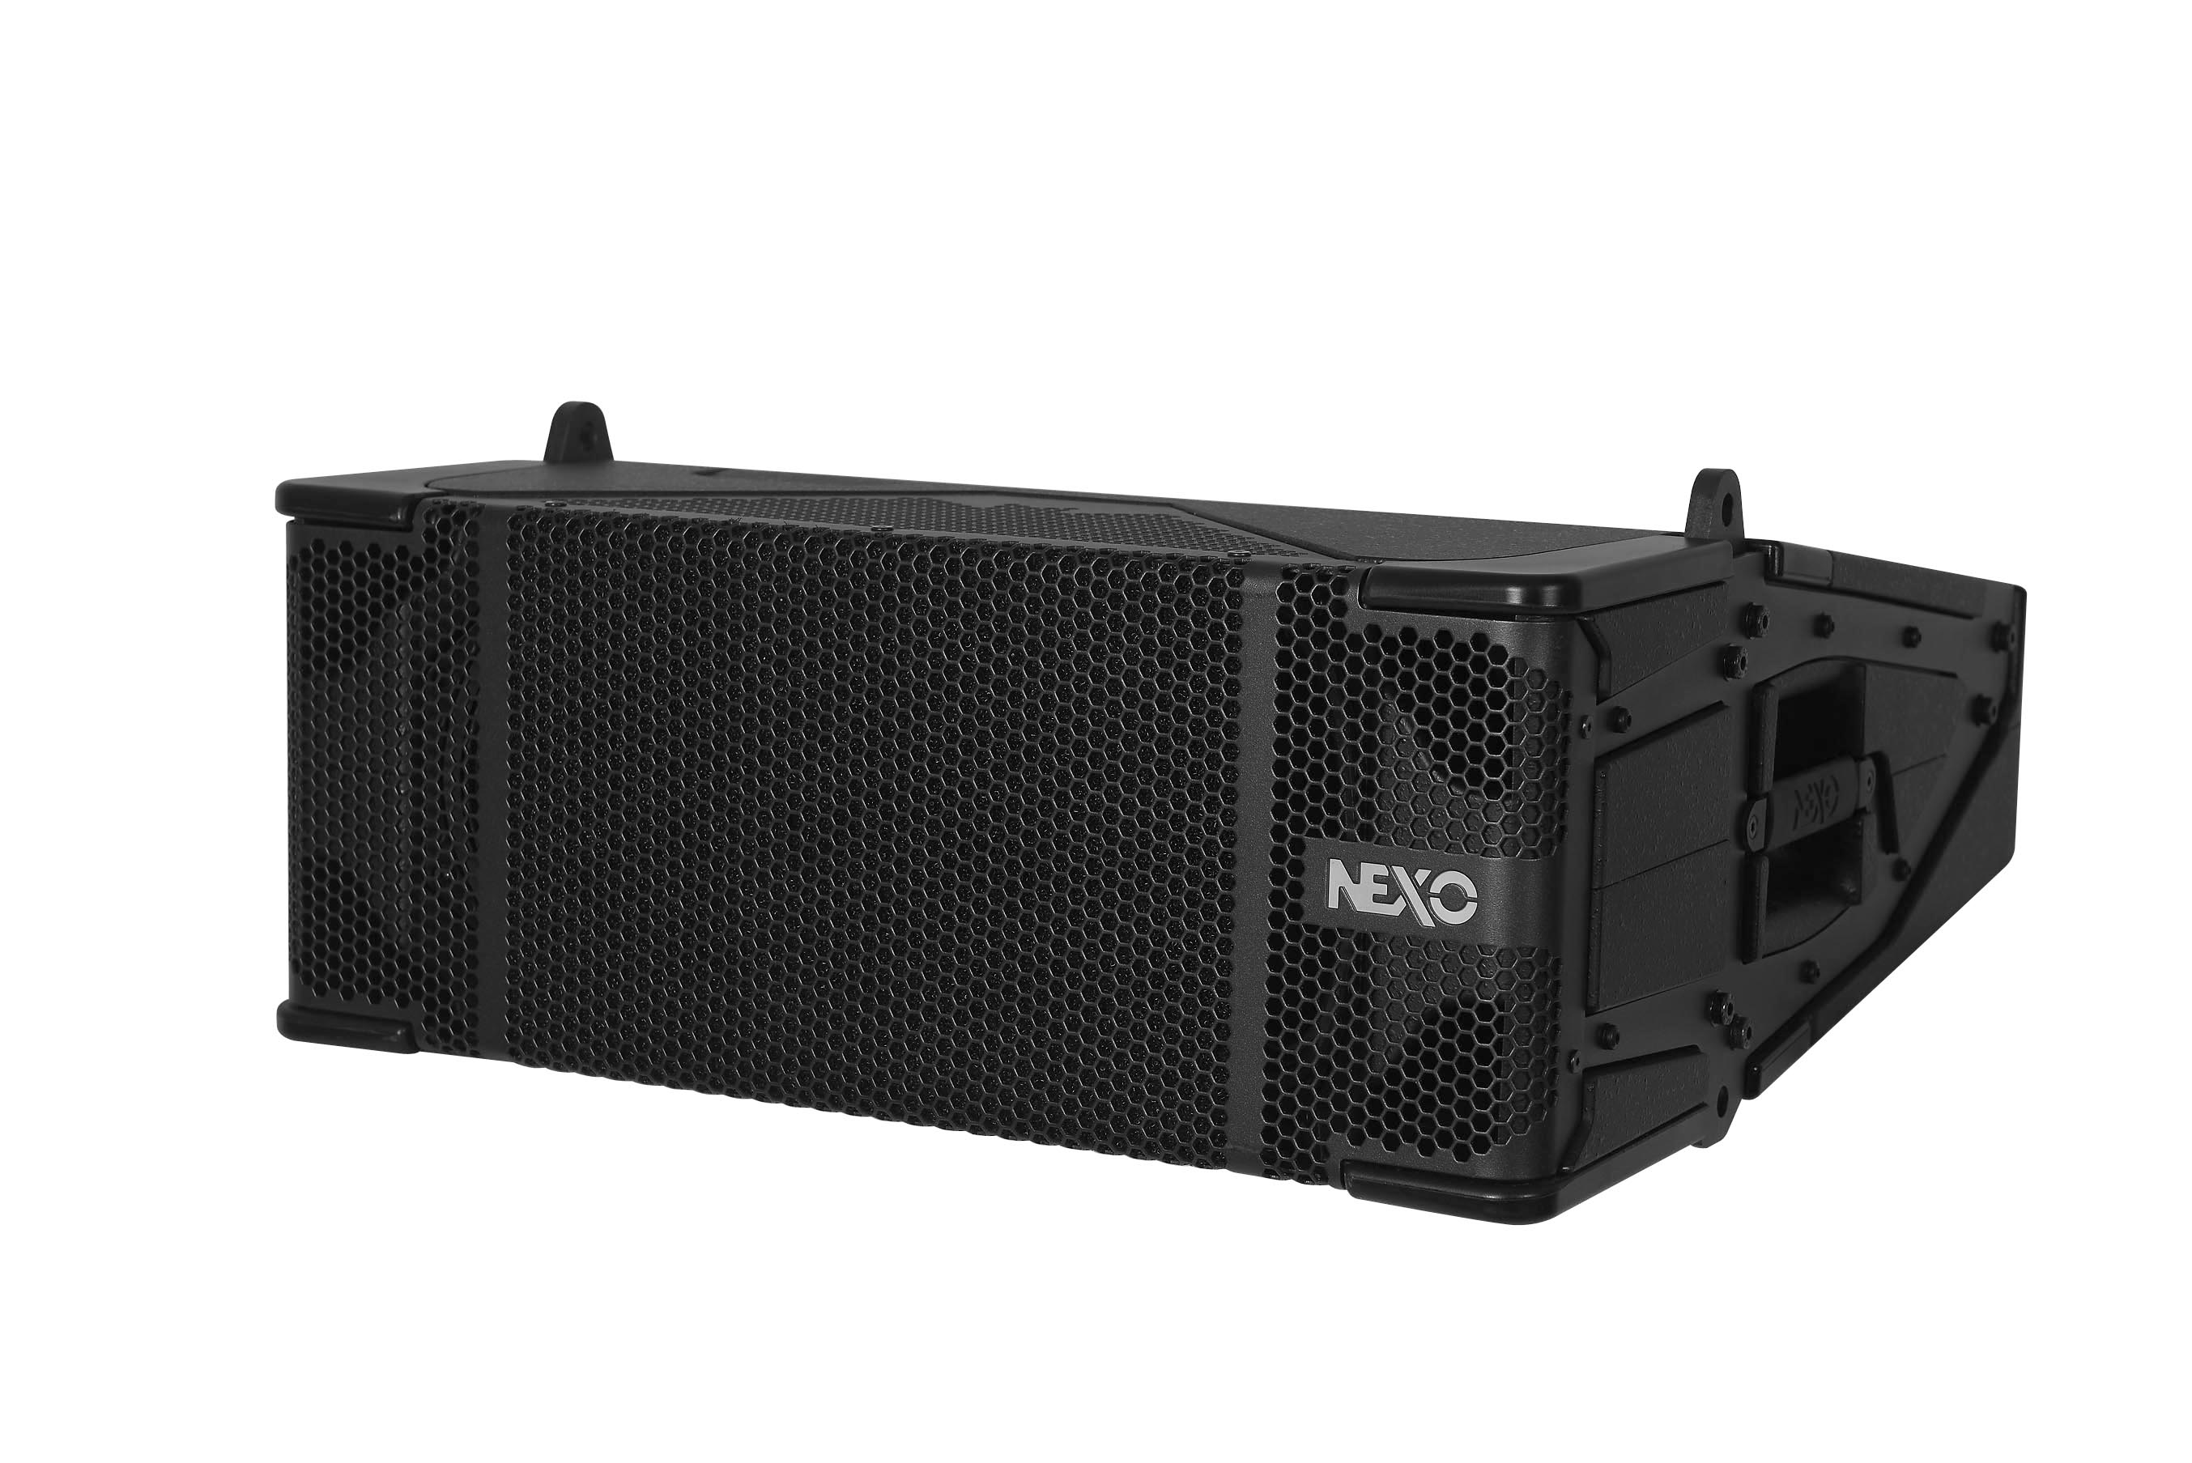
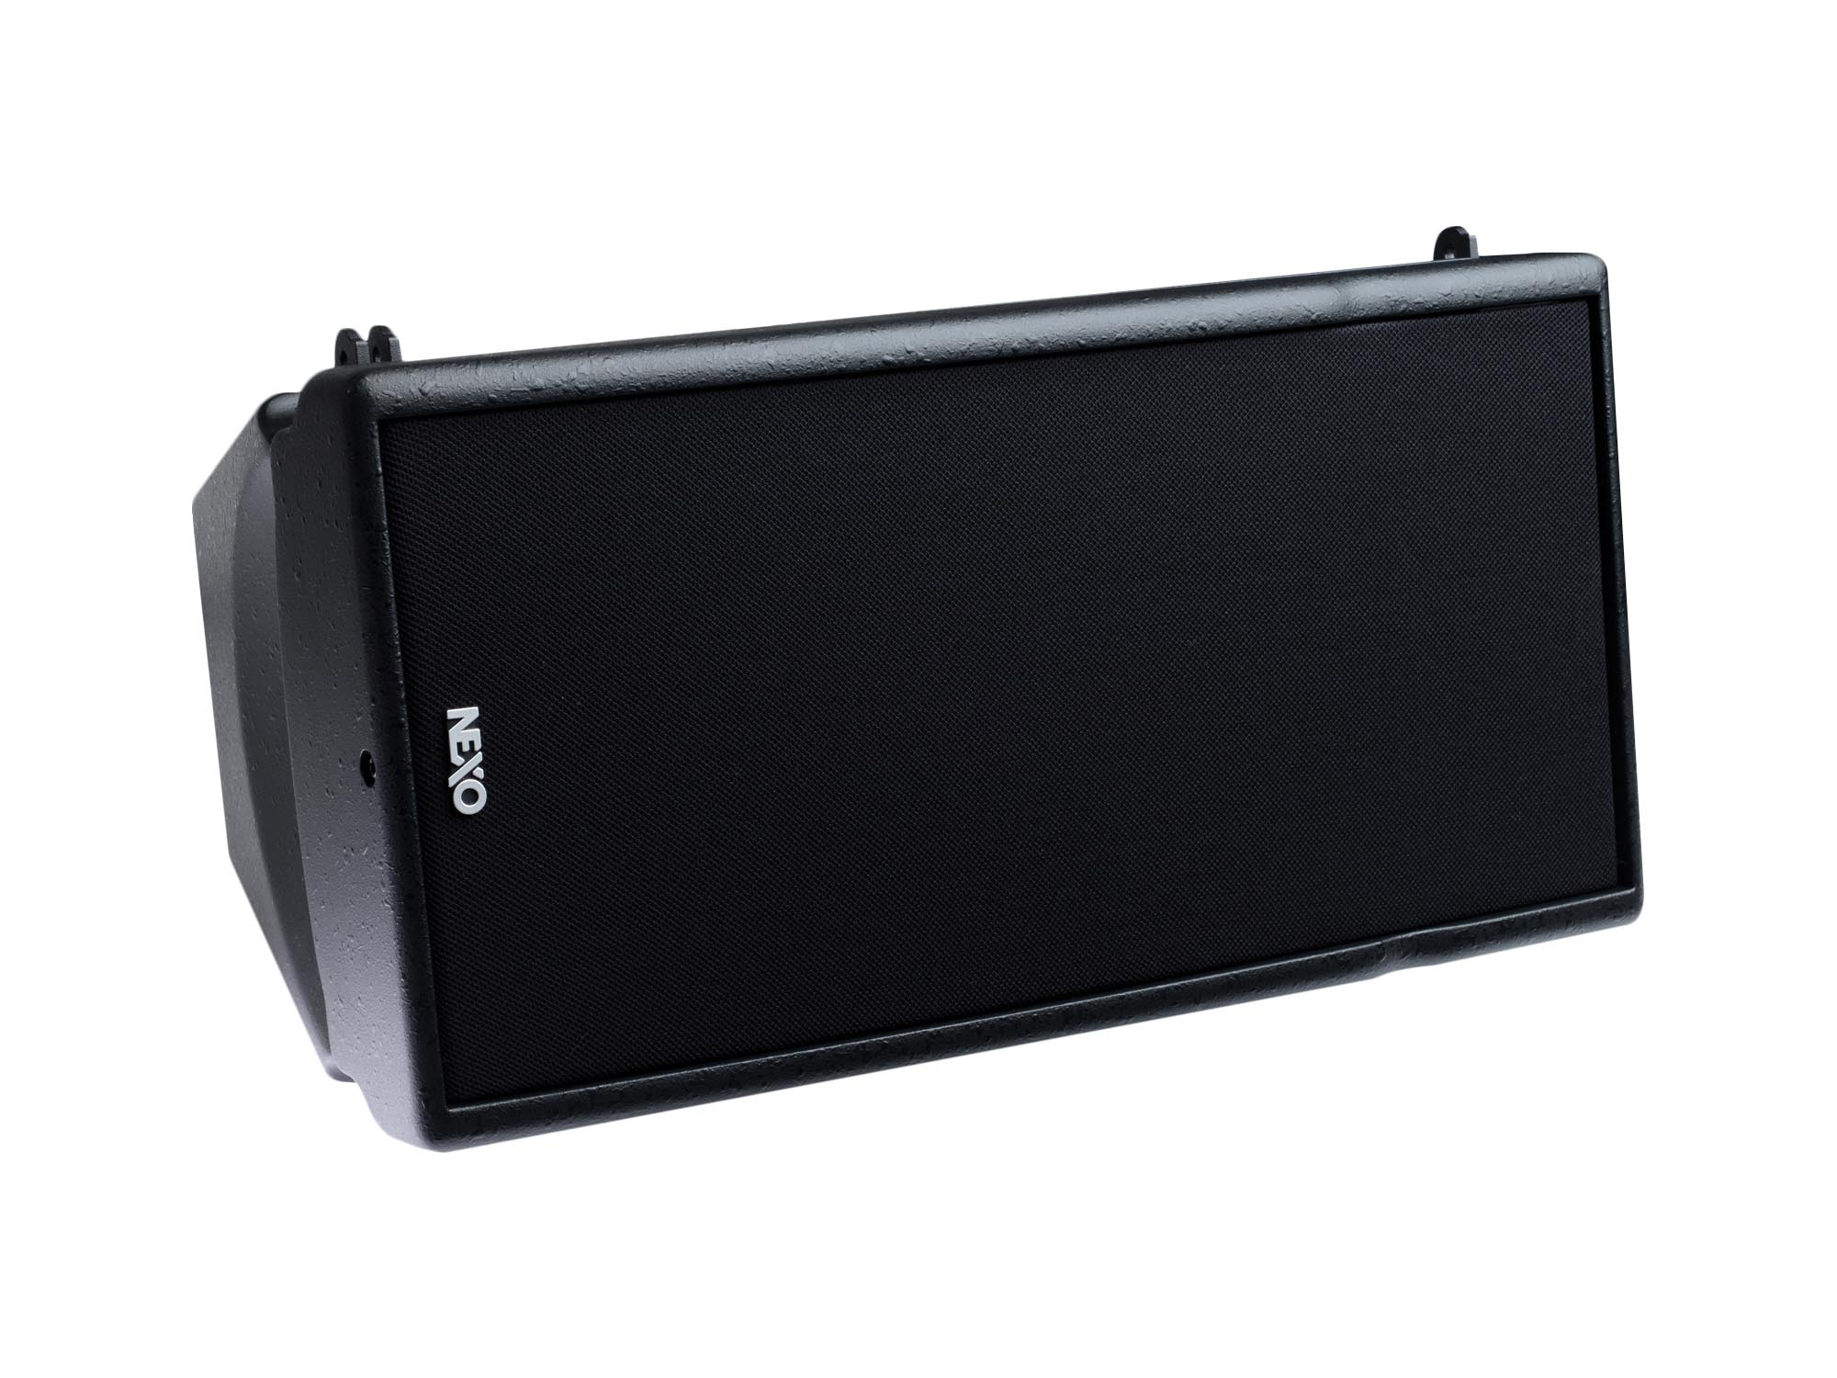
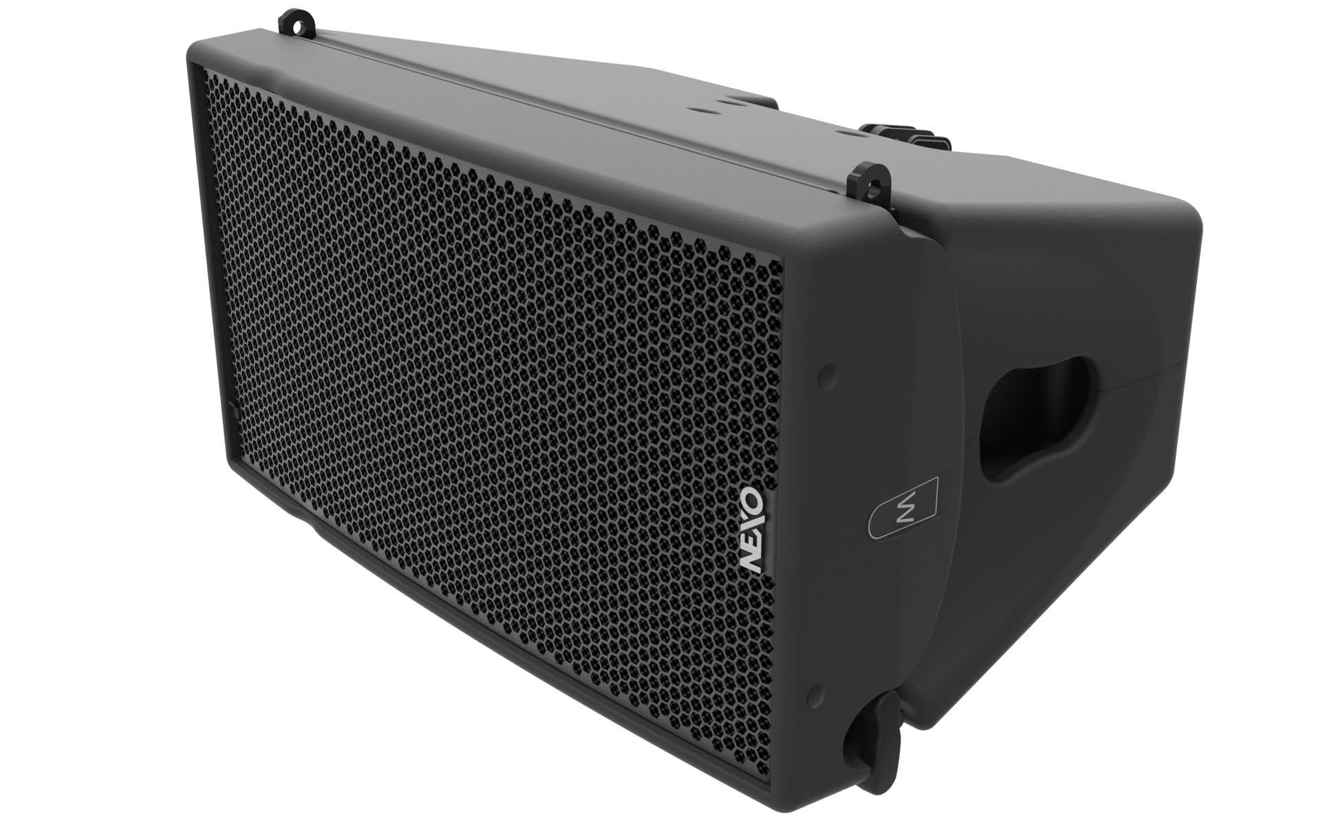
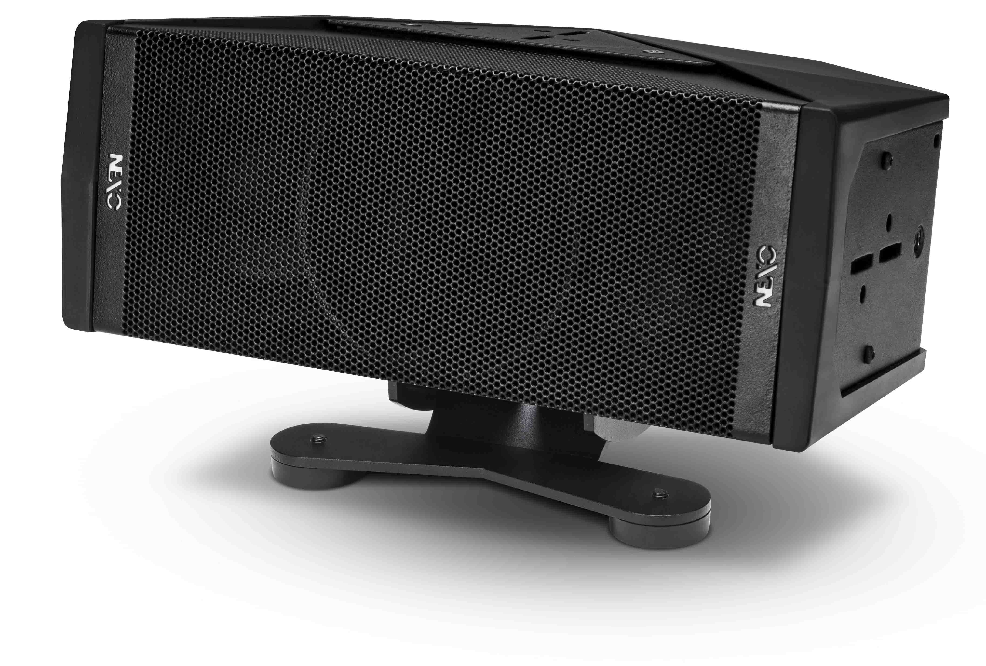
Theatres
Dramatic sound for every seat in the house
ID Series
GEO M6
GEO M10
STM
Ultra-compact speaker. Perfect for ‘beaming’ sound into tricky places like under balconies.
Also perfect as a stage front-fill.
Powerful, compact and light in weight, GEO M6 delivers uncompromised full-range sound and consistent audience coverage.
Great choice for theatres and conference halls in both mobile and fixed installations.
Thanks to its modularity philosophy, STM makes it easy to configure and fly the perfect sound system for any type and size of theatre.

Slide 7
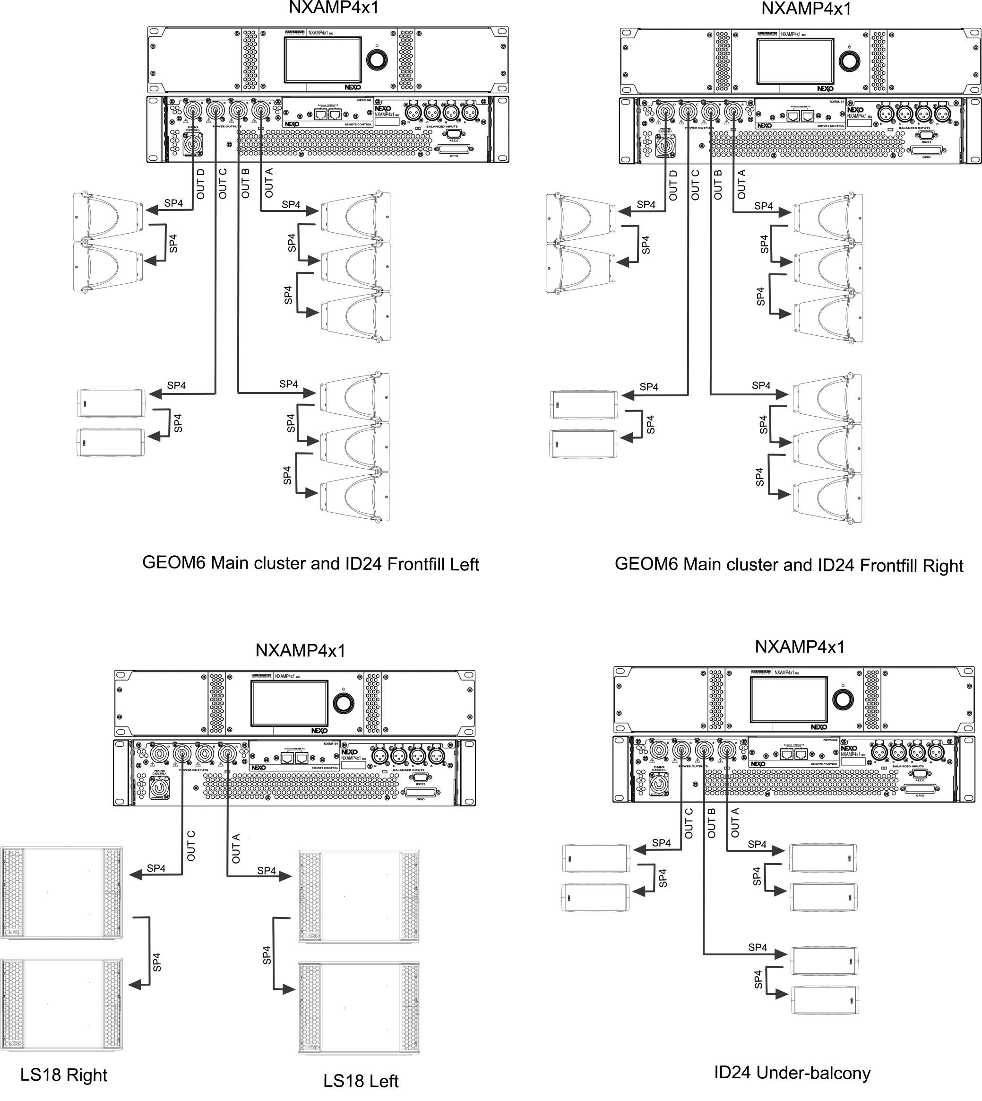
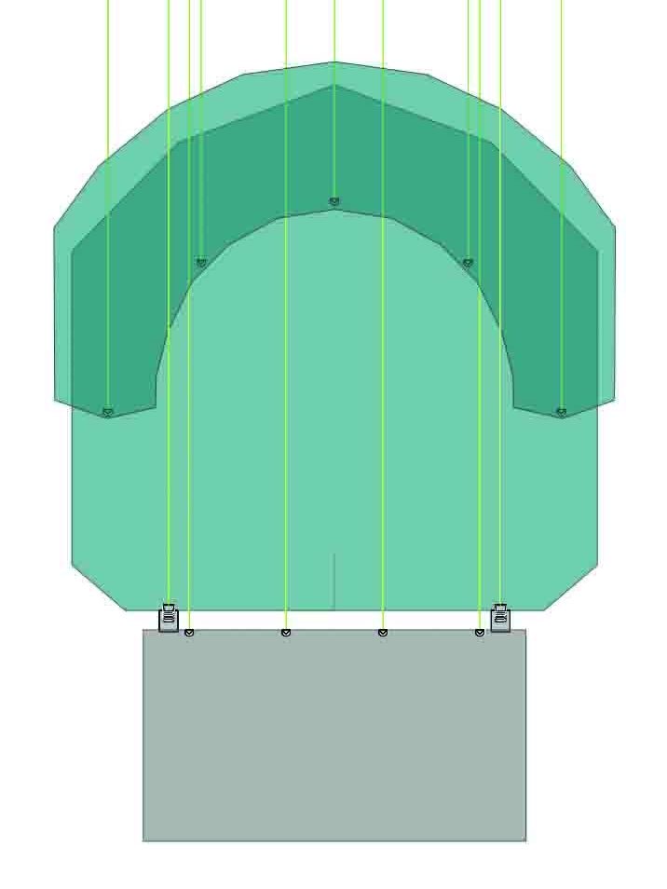
Theatre top view
Applications

Slide 8
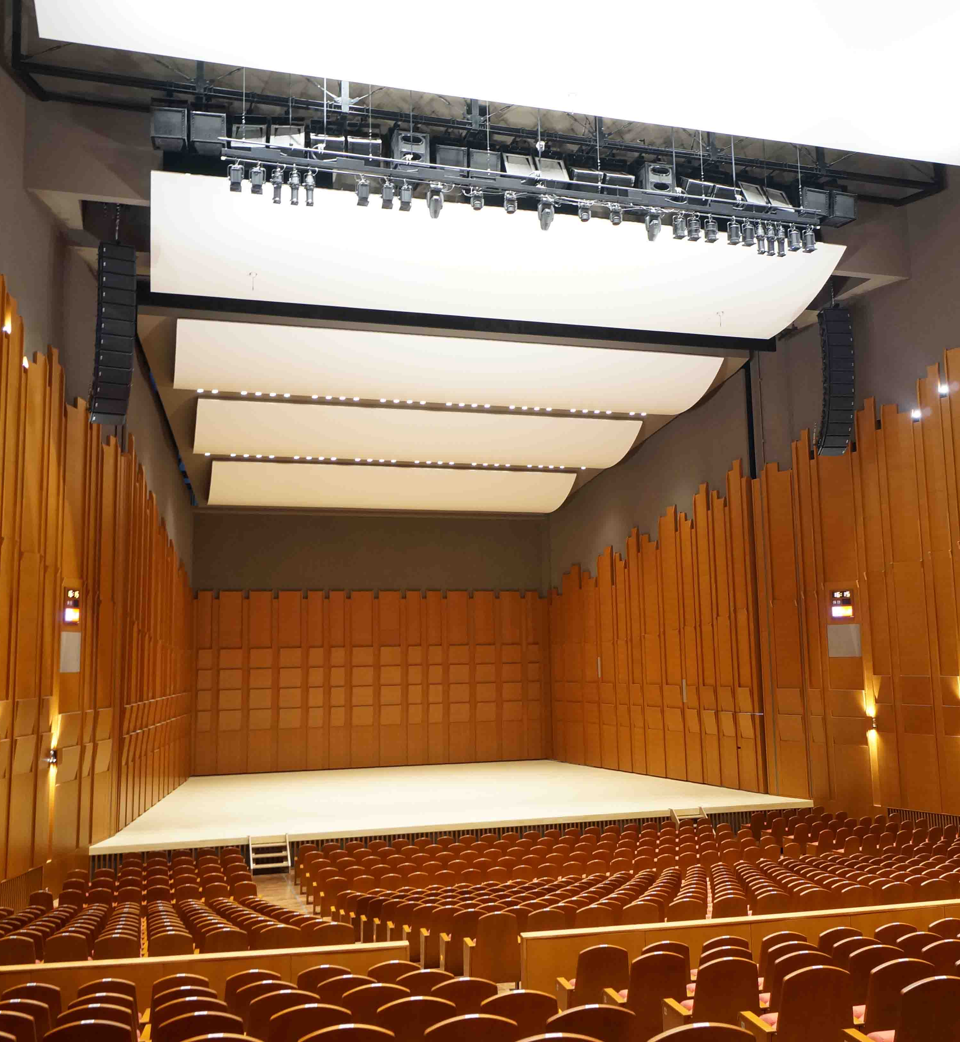
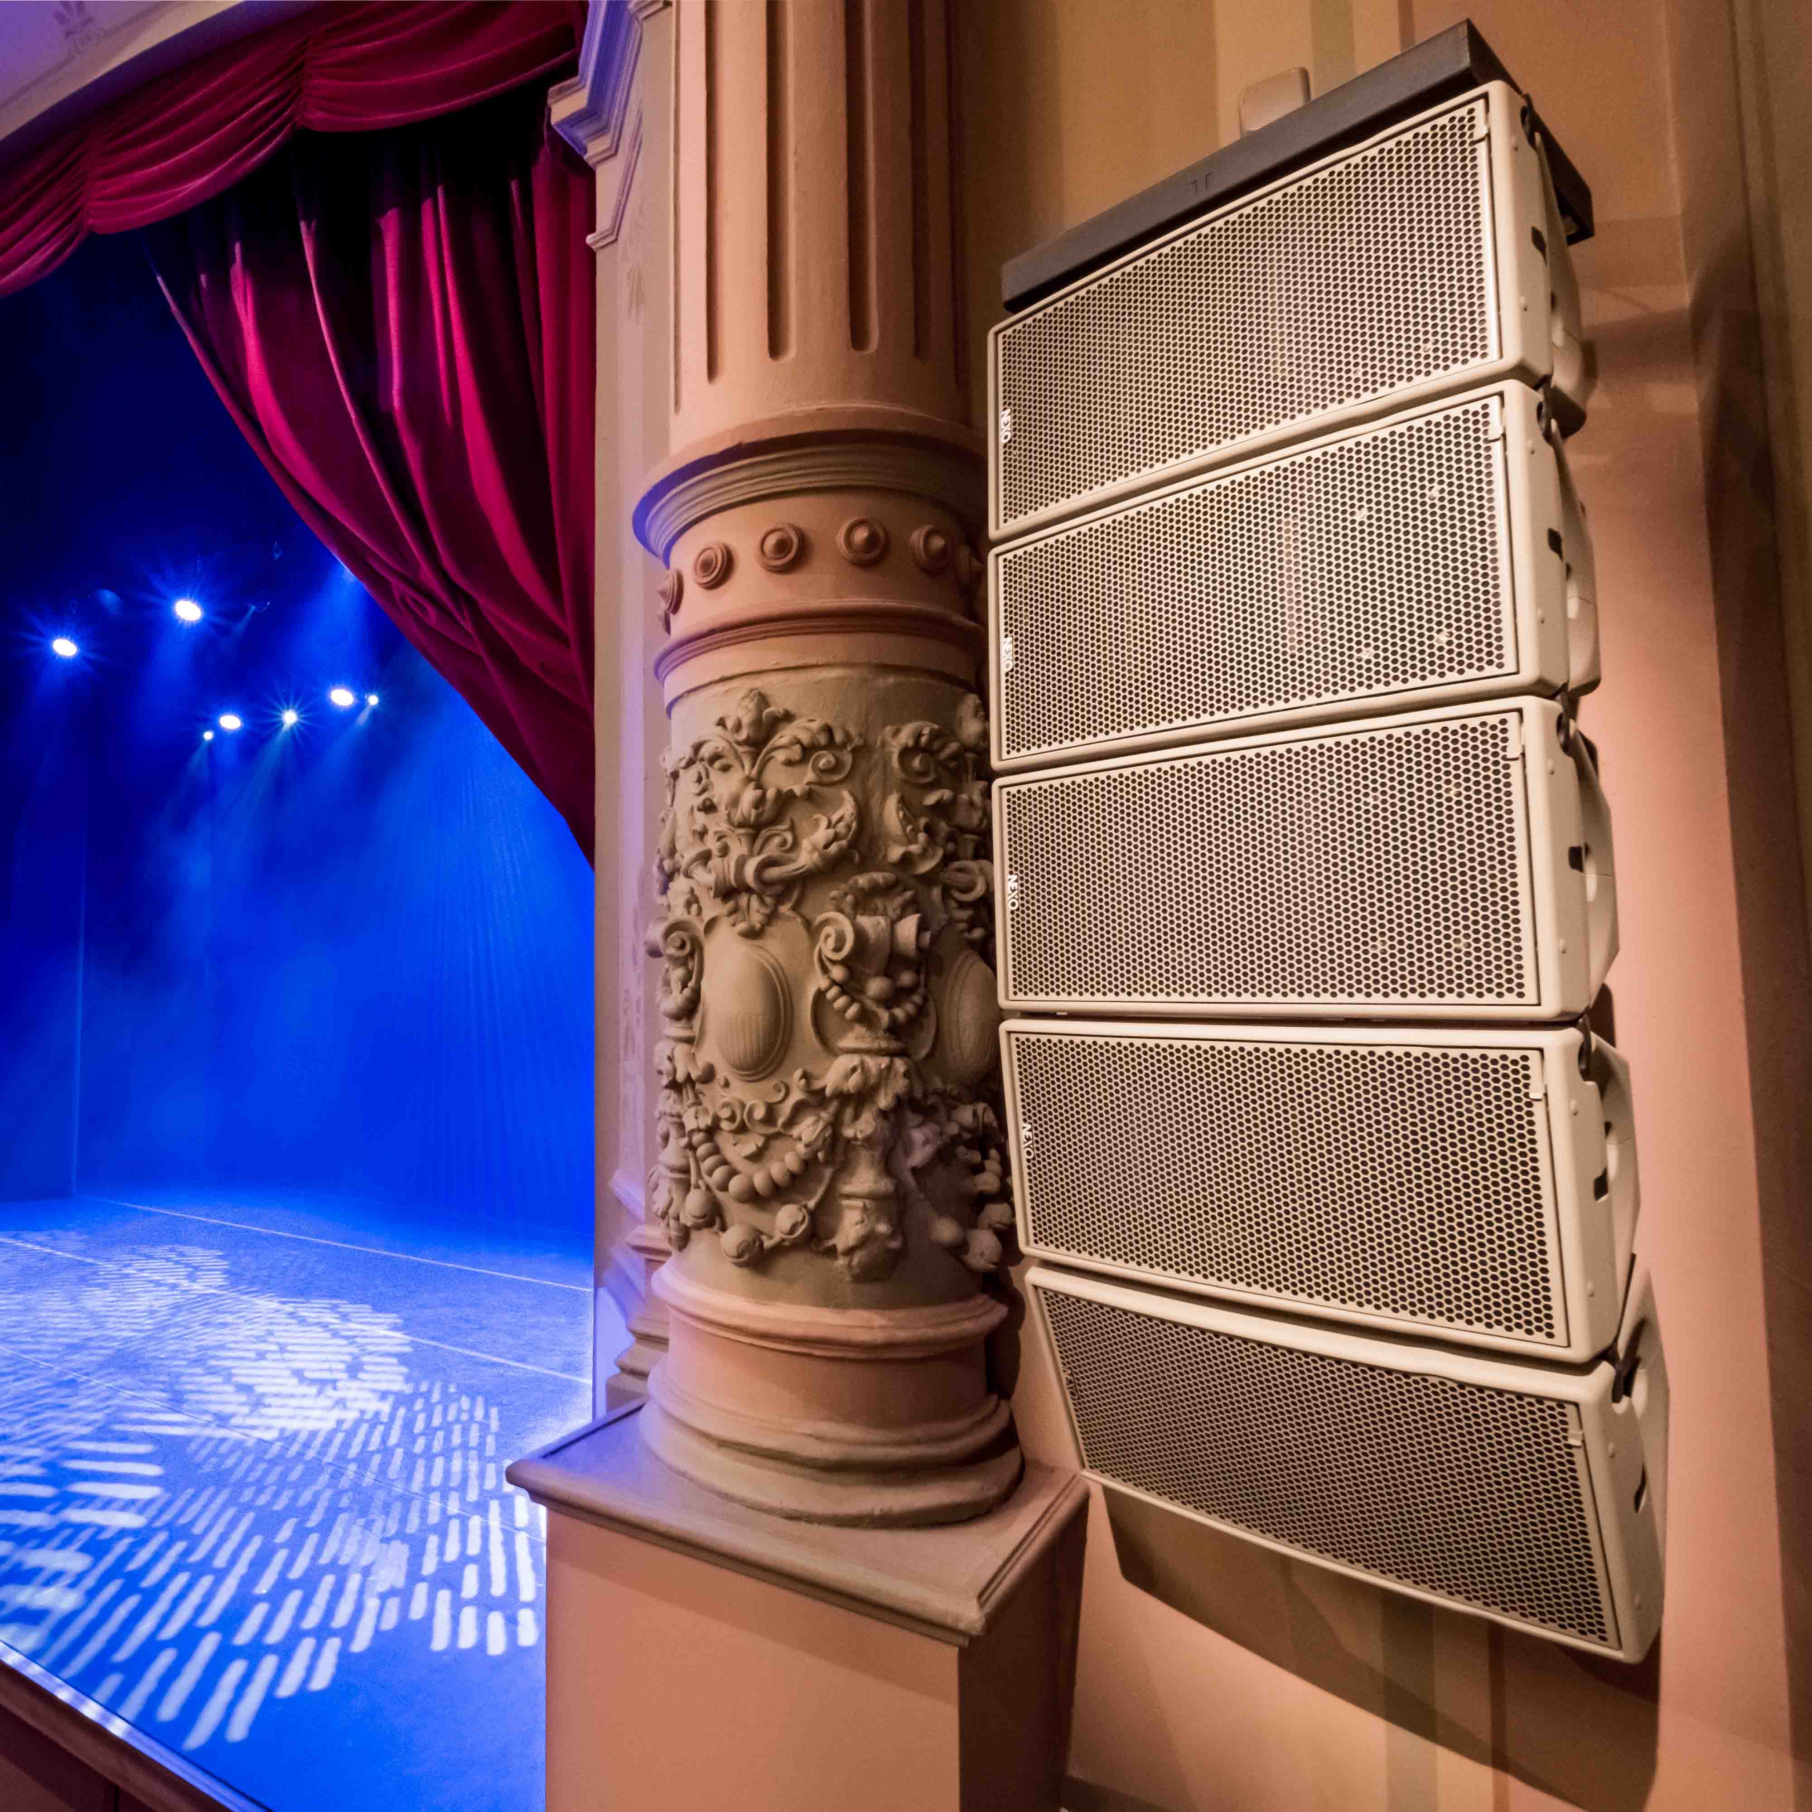
Case Studies
Westa Kawagoe Arts Centre, Japan
Main system uses GEO S12.
STM used for moveable stage speakers.
Stasgenhoorzaal, Holland
L/R olive green GEO M6 arrays combine with a centre GEO M6 cluster.

Slide 9
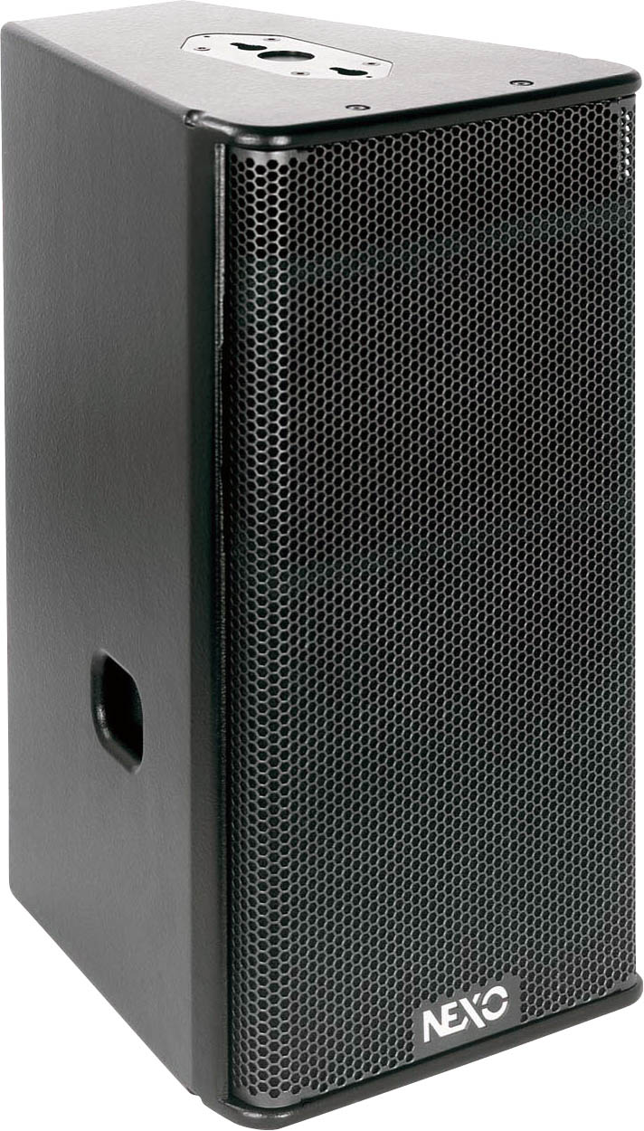
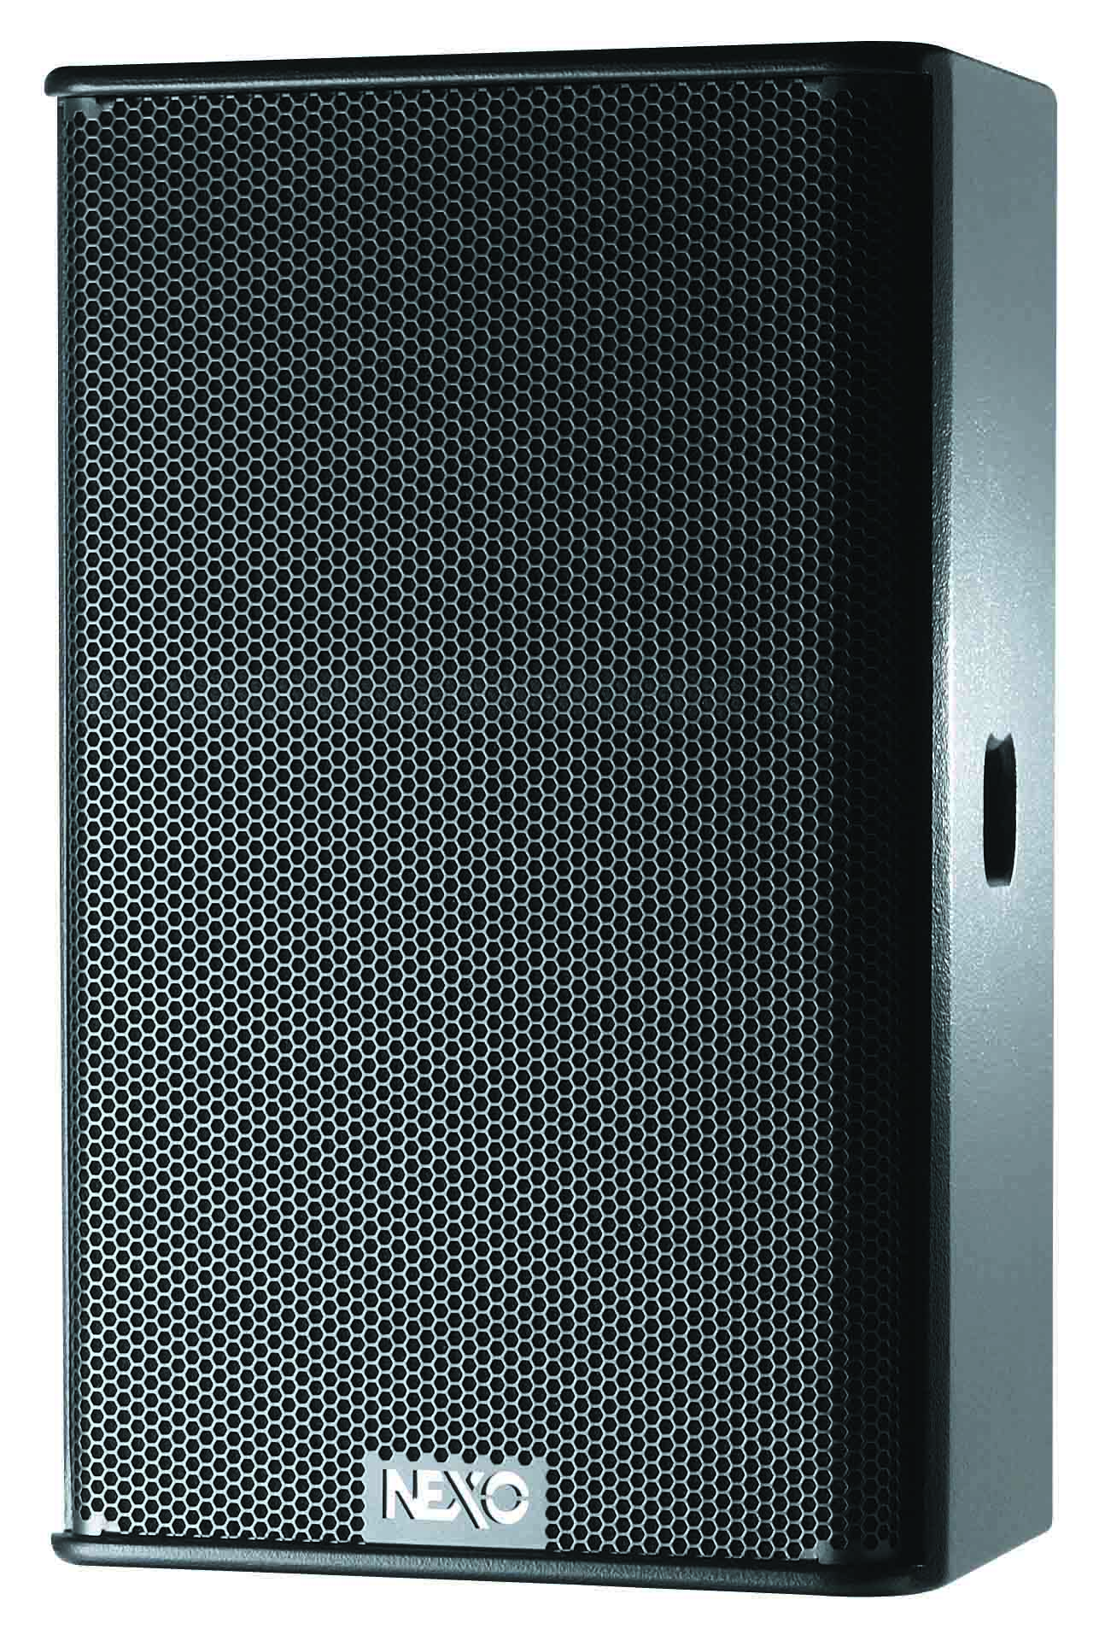
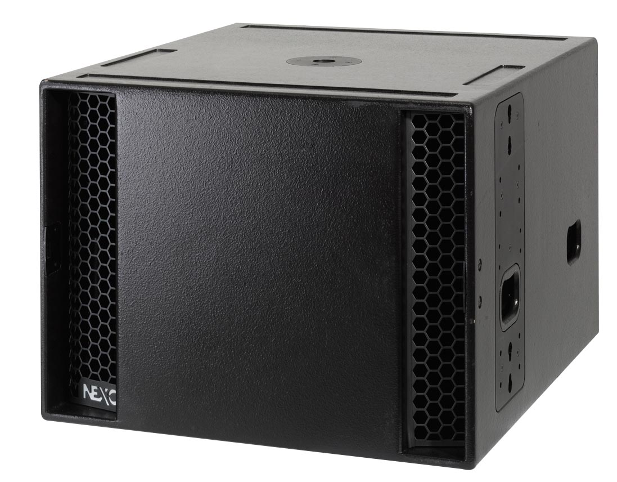
Clubs
Thrilling the dancefloor
GEO S12
PS Series
STM
LS18
From mobile DJ to fixed installations, NEXO GEO S12 series extends GEO’s reputation for unrivalled flexibility without compromise.
A club favourite for decades with hundreds of thousands of cabinets in use thanks to its high SPL performance, versatile mounting options
The first choice of many high-profile DJs, this truly modular system can be configured in compact groundstacks or flown in arrays.
LS18 is perfect for enhancing for the low end performance of PS Series or GEO S12 systems, extending bass response down to 30Hz.

Slide 10
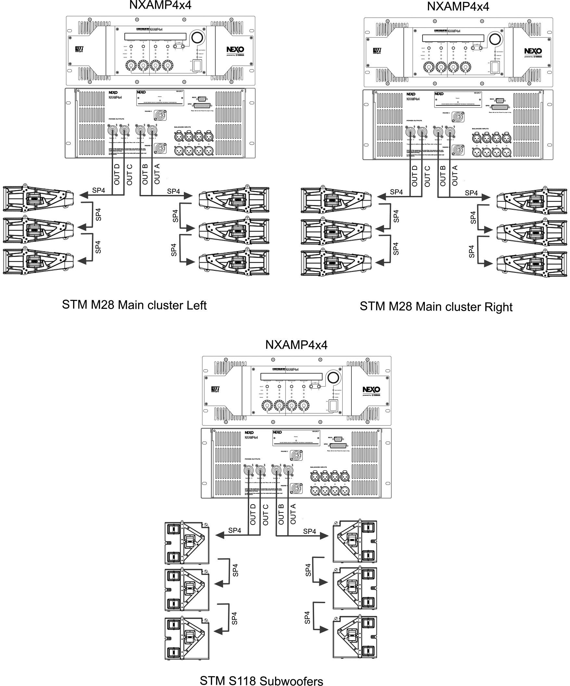
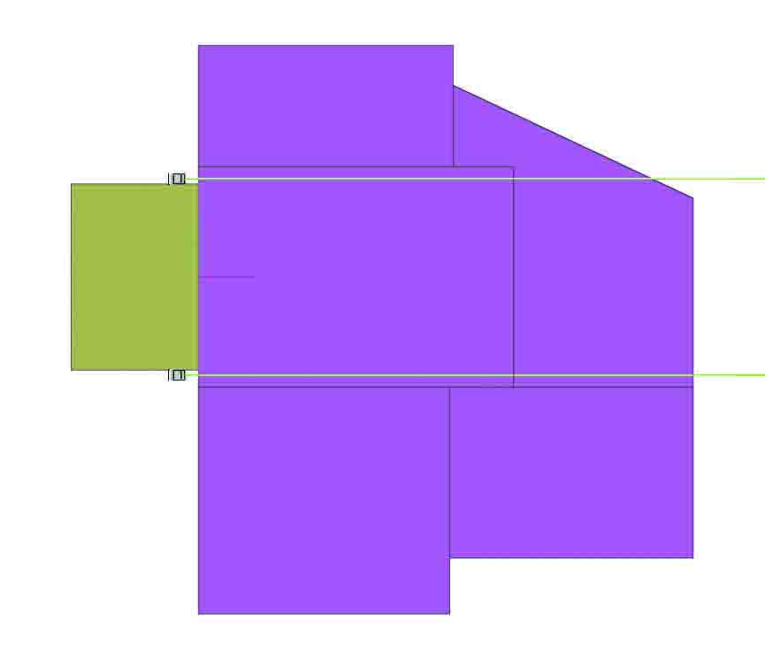
Club top view
Applications

Slide 11
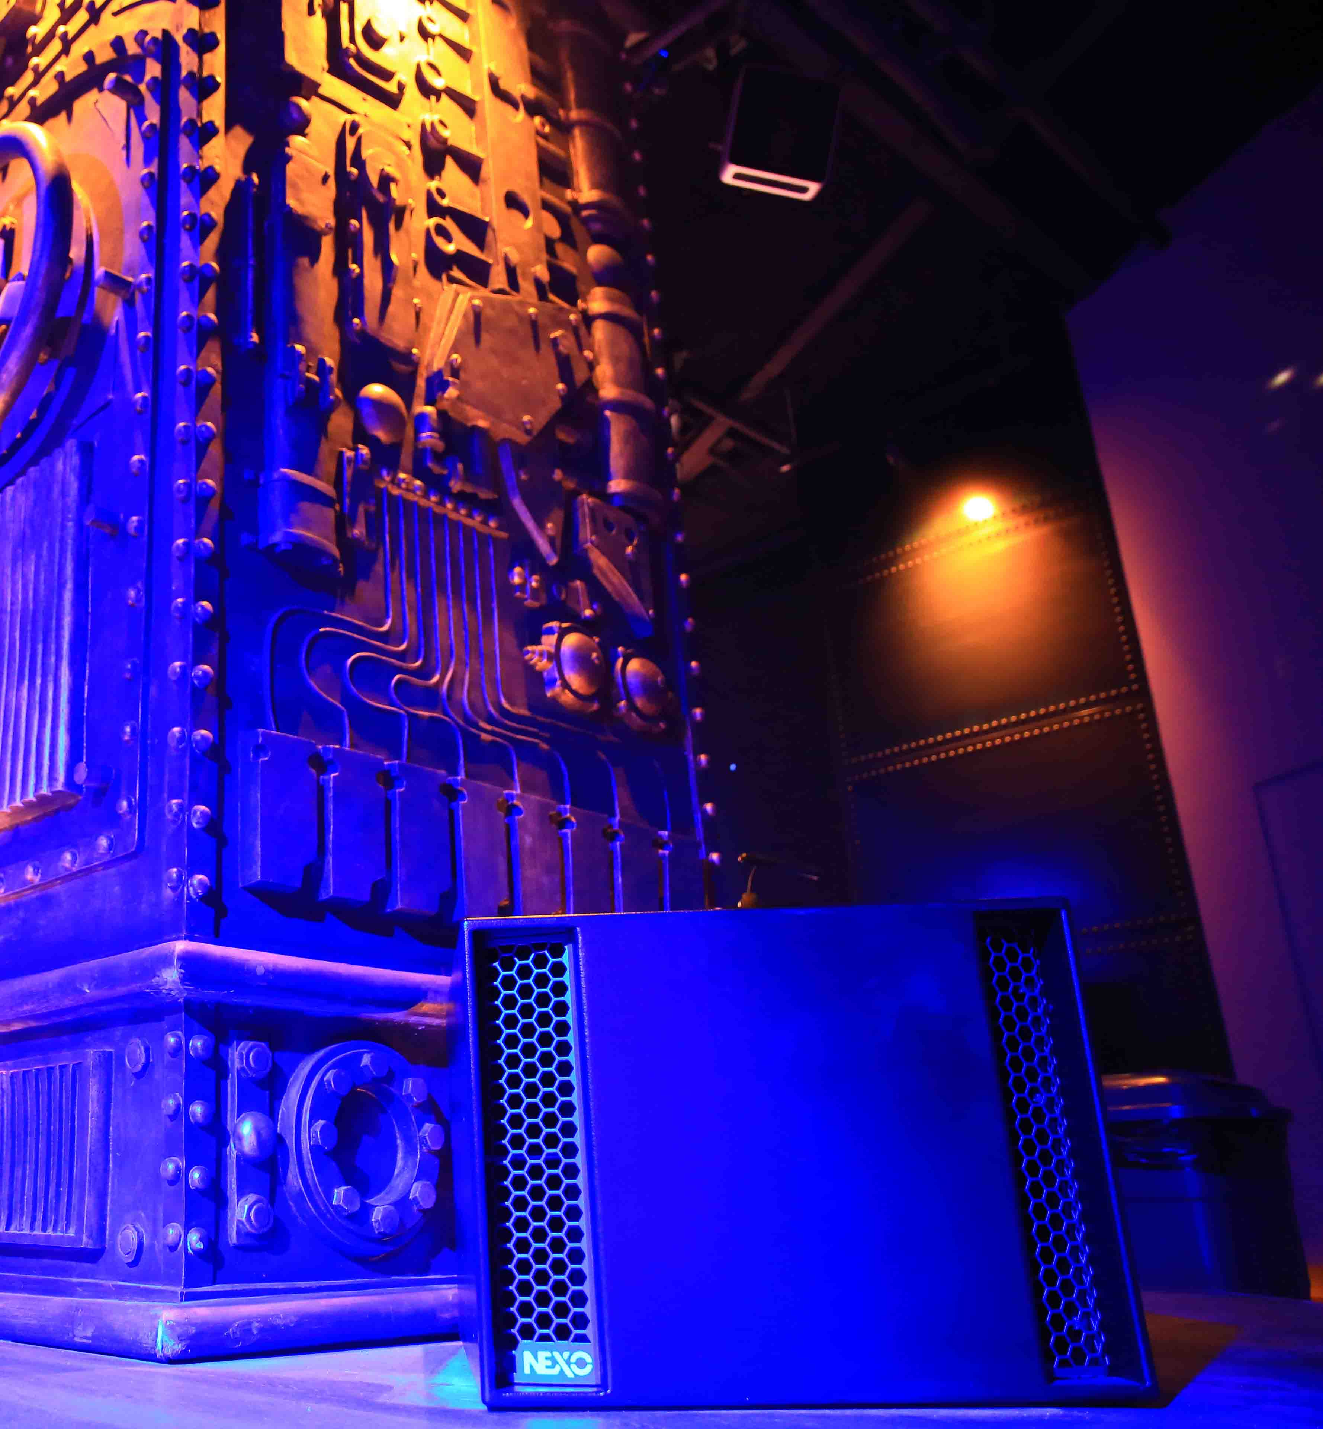
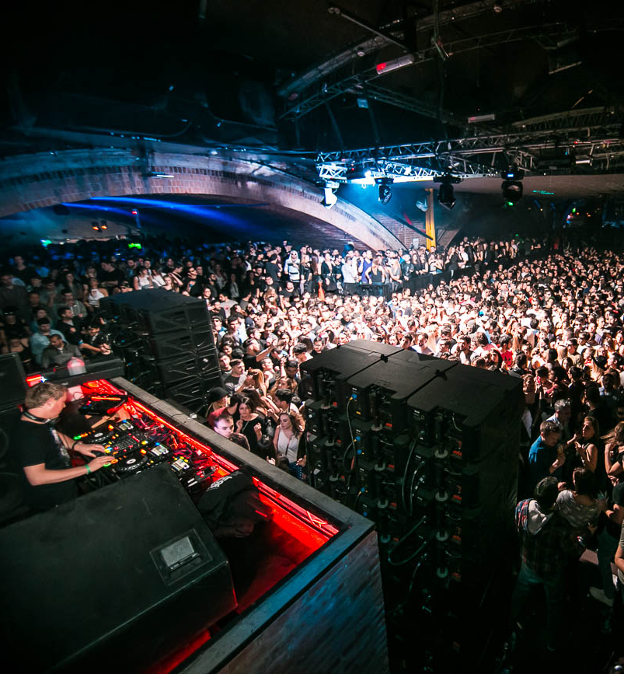
Case Studies
V Livehouse, China
LS18 subs complement an STM main system with
PS Series cabinets used as front fills and stage monitors.
Crobar, Argentina
John Digweed uses triple-wide STM groundstacks to create a stunning sound at a gig in Argentina.

Slide 12
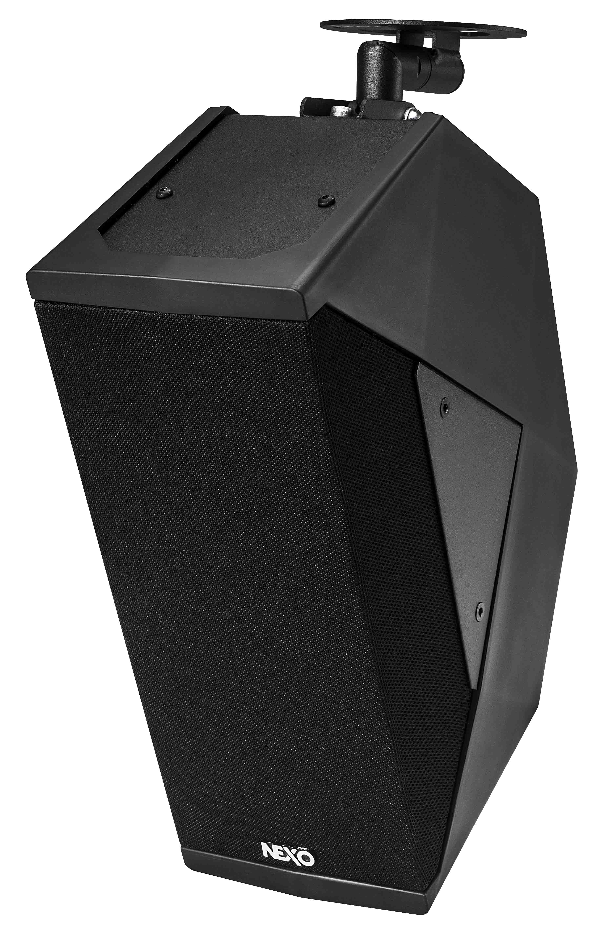
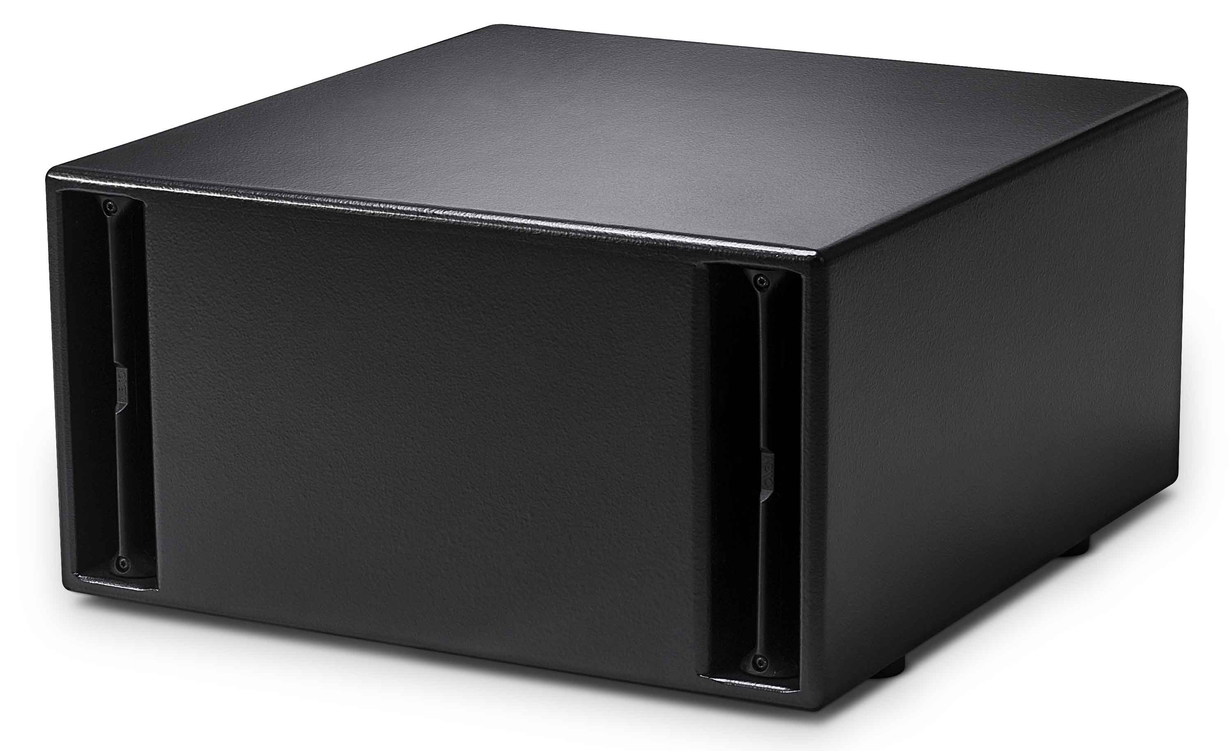
Bars & Restaurants
Creating the perfect vibe
ID Series
PS Series
GEO M6
ID S110
Elegant and compact, NEXO’s ID24 cabinet is available in a range of custom colours and supported by a range of mounting hardware.
A great choice for larger venues where the music is about more than creating a background atmosphere, the PS Series can deliver high SPLs when called upon.
With its compact form factor, integral rigging and custom RAL colours, GEO M6 delivers advanced NEXO line array technology in a TÜV-certified system.
Part of the ID Series, this compact and powerful 1 x 10″ sub offers punchy sub bass performance in a low-profile form factor. Perfect for discrete installation.

Slide 13
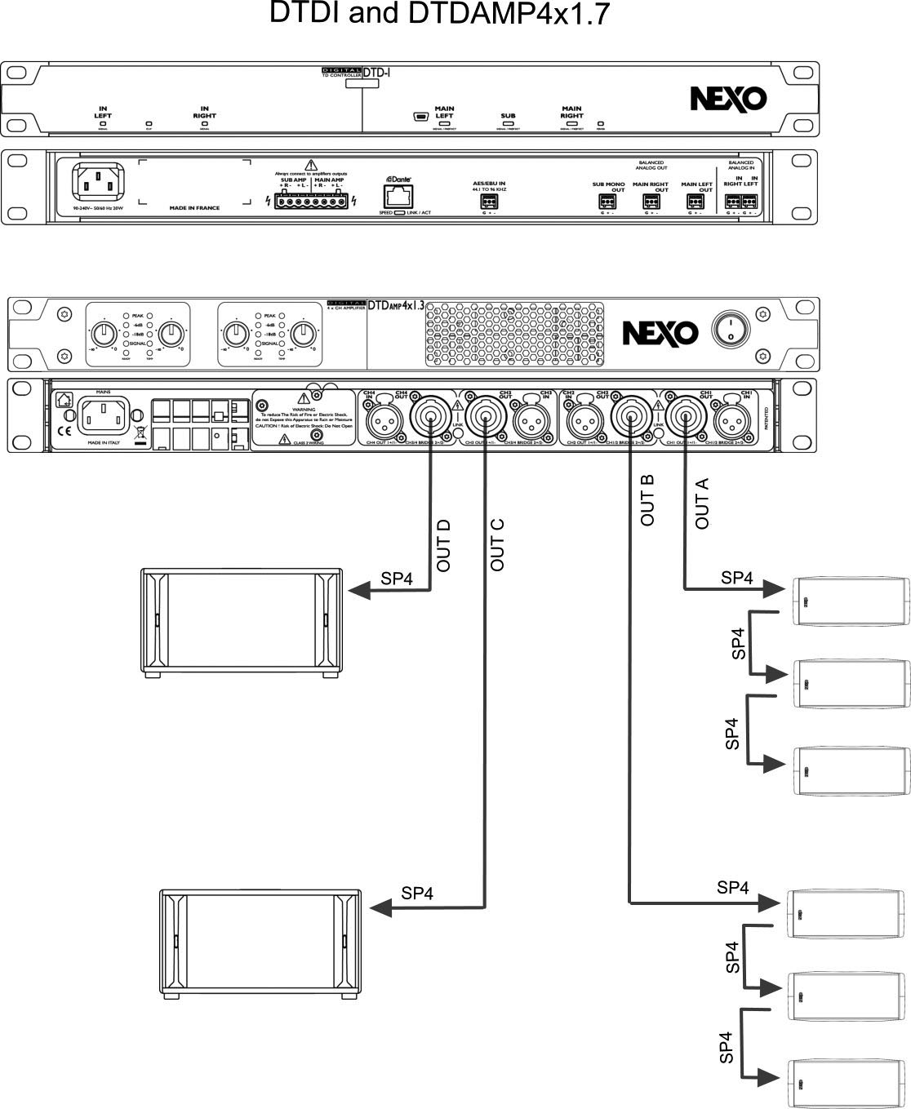
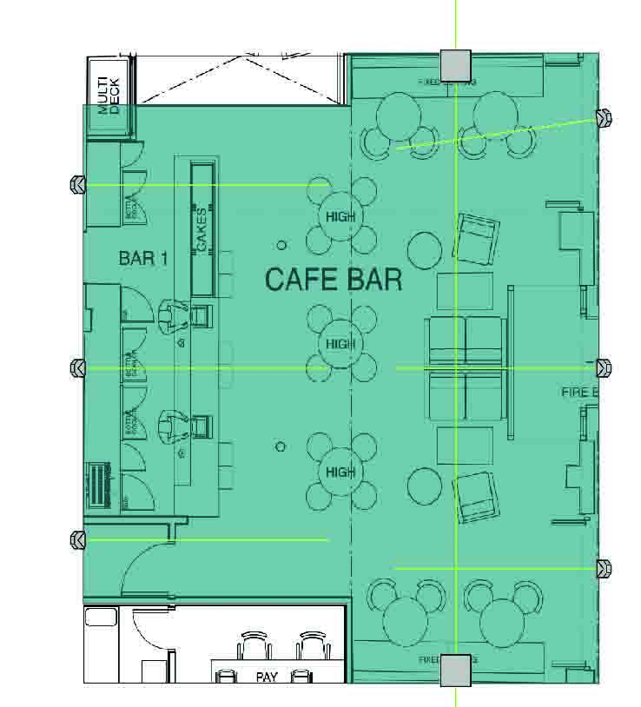
Bar top view
Applications

Slide 14
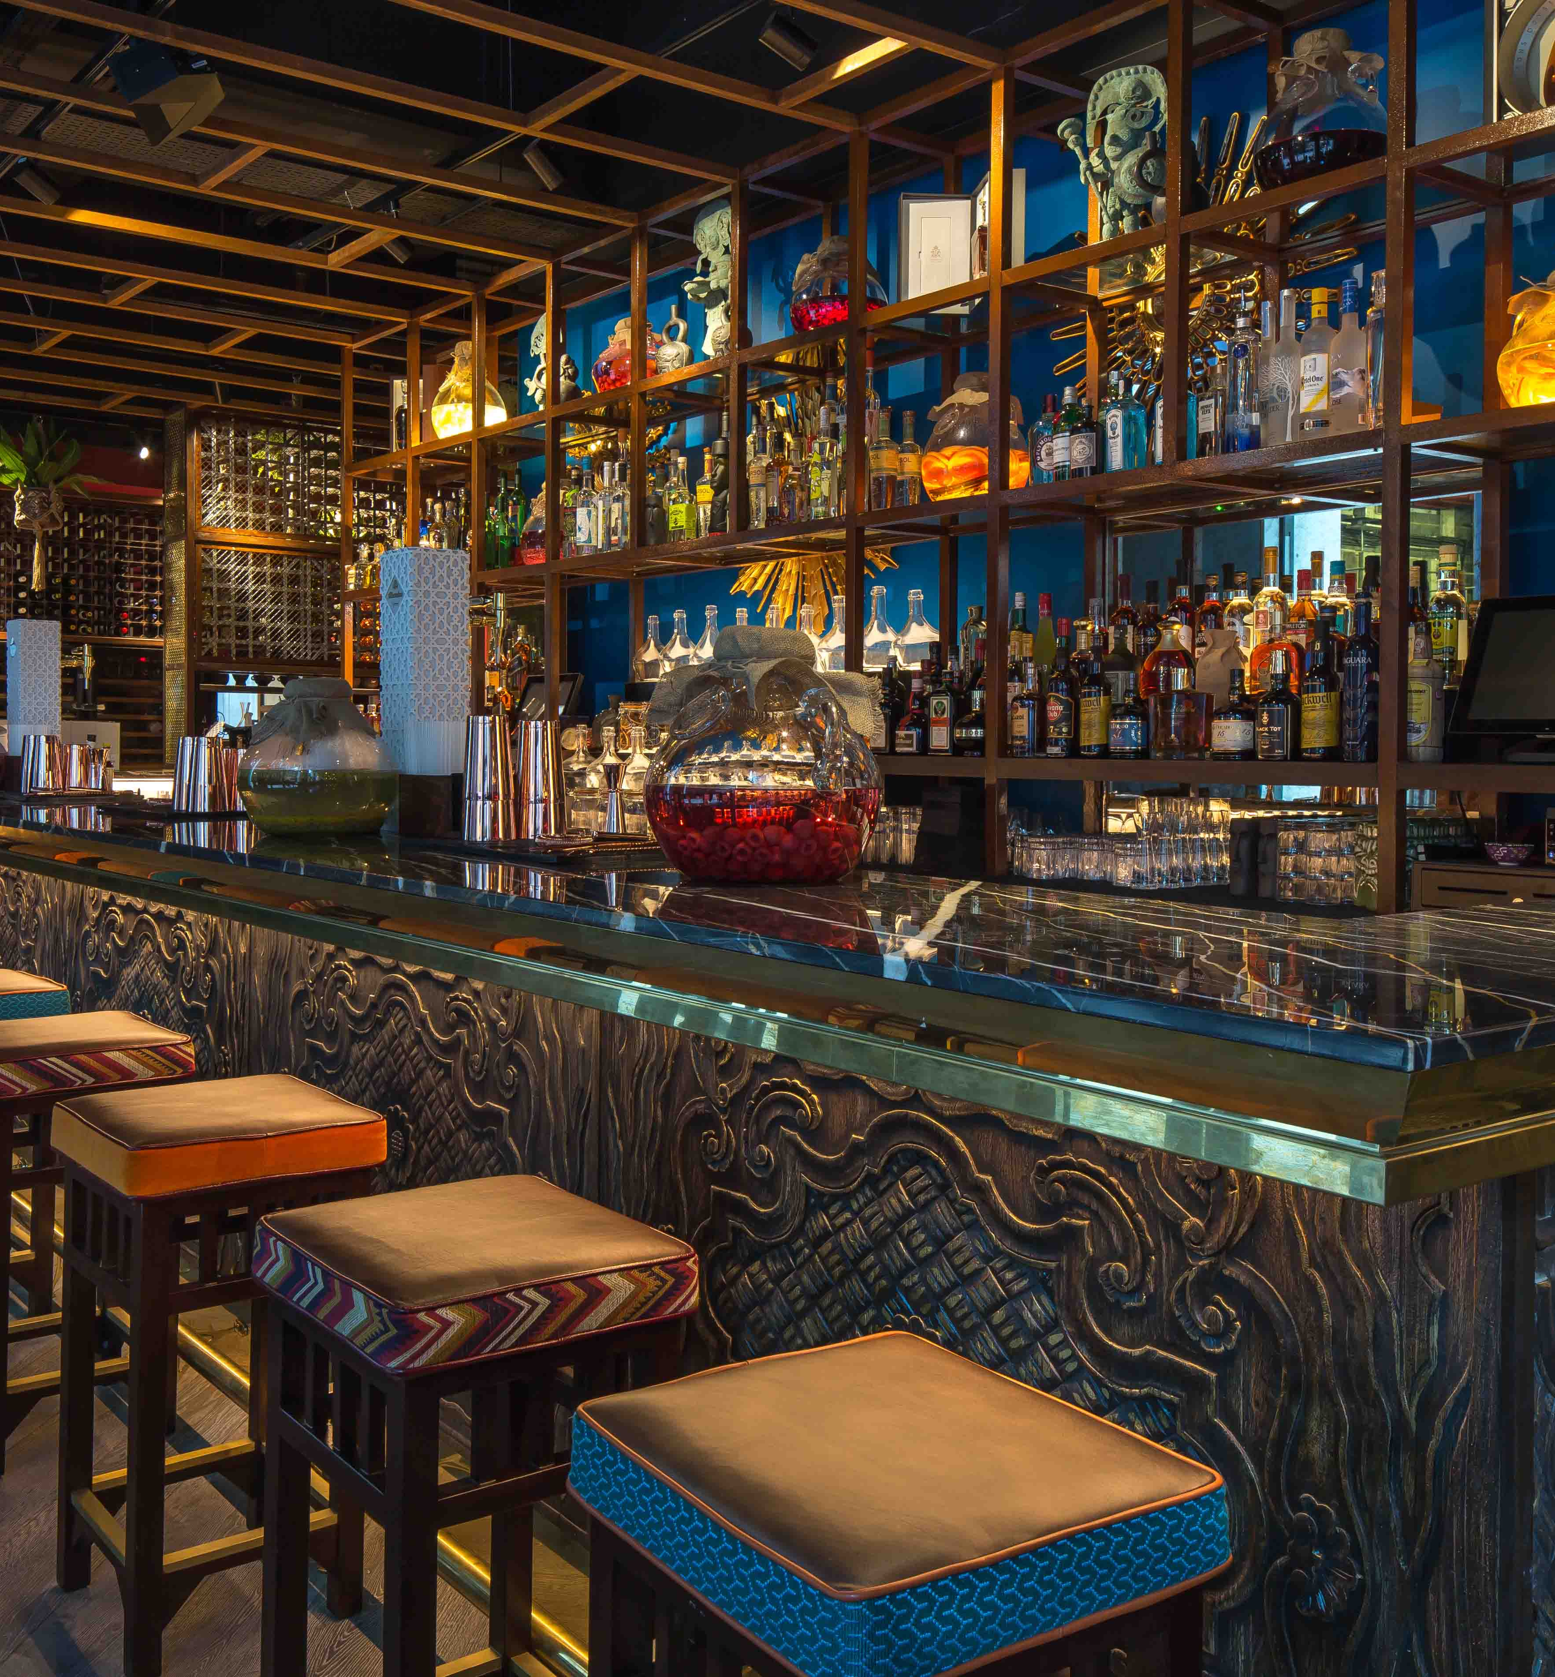
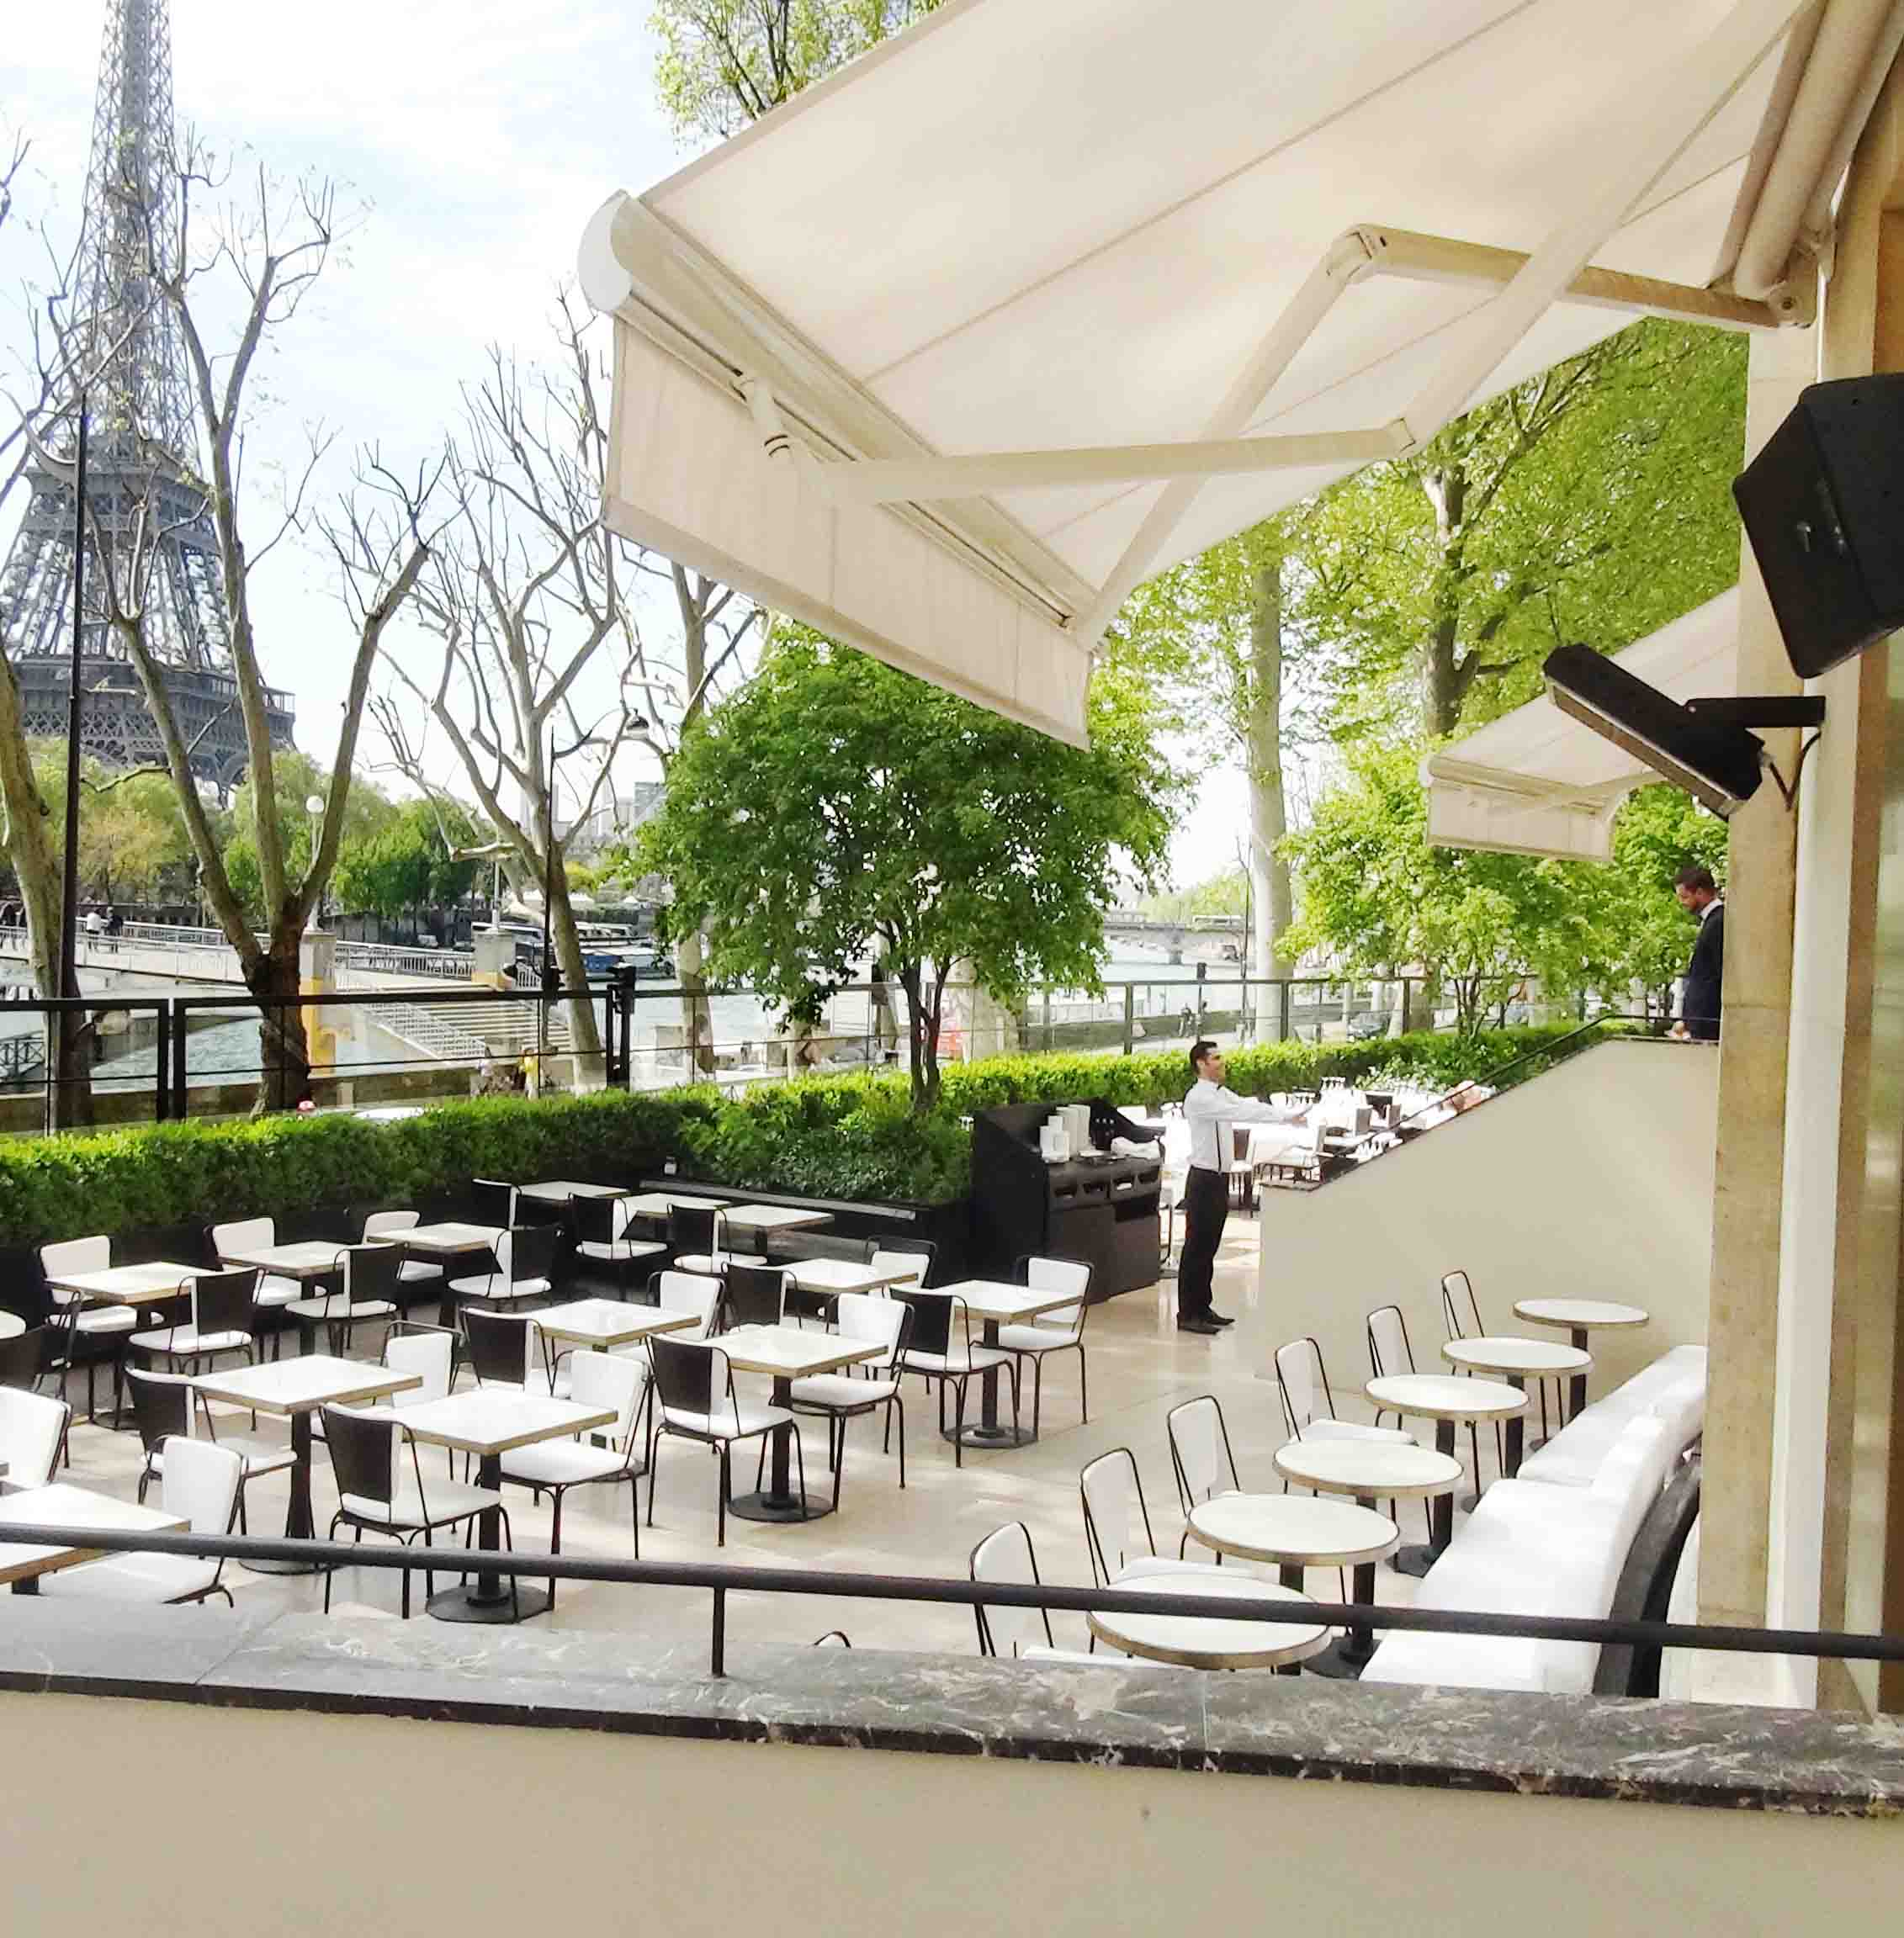
Case Studies
COYA, UK
AV design company Vibasound spec’s an ID Series system with S110 subs in this new Latin American restaurant in London.
Monsieur Bleu, Paris
NEXO speakers and a spectacular view create the perfect outdoor dining experience at this Paris restaurant.

Slide 15
Houses of Worship
Spreading the word
GEO M6
GEO M10
GEO S12
STM
NEXO’s smallest line array box combines a compact form factor, integral rigging, elegant hardware, and custom RAL colours in a TÜV-certified system.
In larger houses of worship, NEXO’s most advanced line array box draws on patented technologies and a Neodymium-magnet 10” driver.
Horizontal or vertical rigging options and a choice of standard or long-throw cabinets make GEO S12 a flexible system with excellent performance.
Comprising Main, Bass, Sub and Omni modules, STM provides building blocks for the ideal sound reinforcement system.

Slide 16
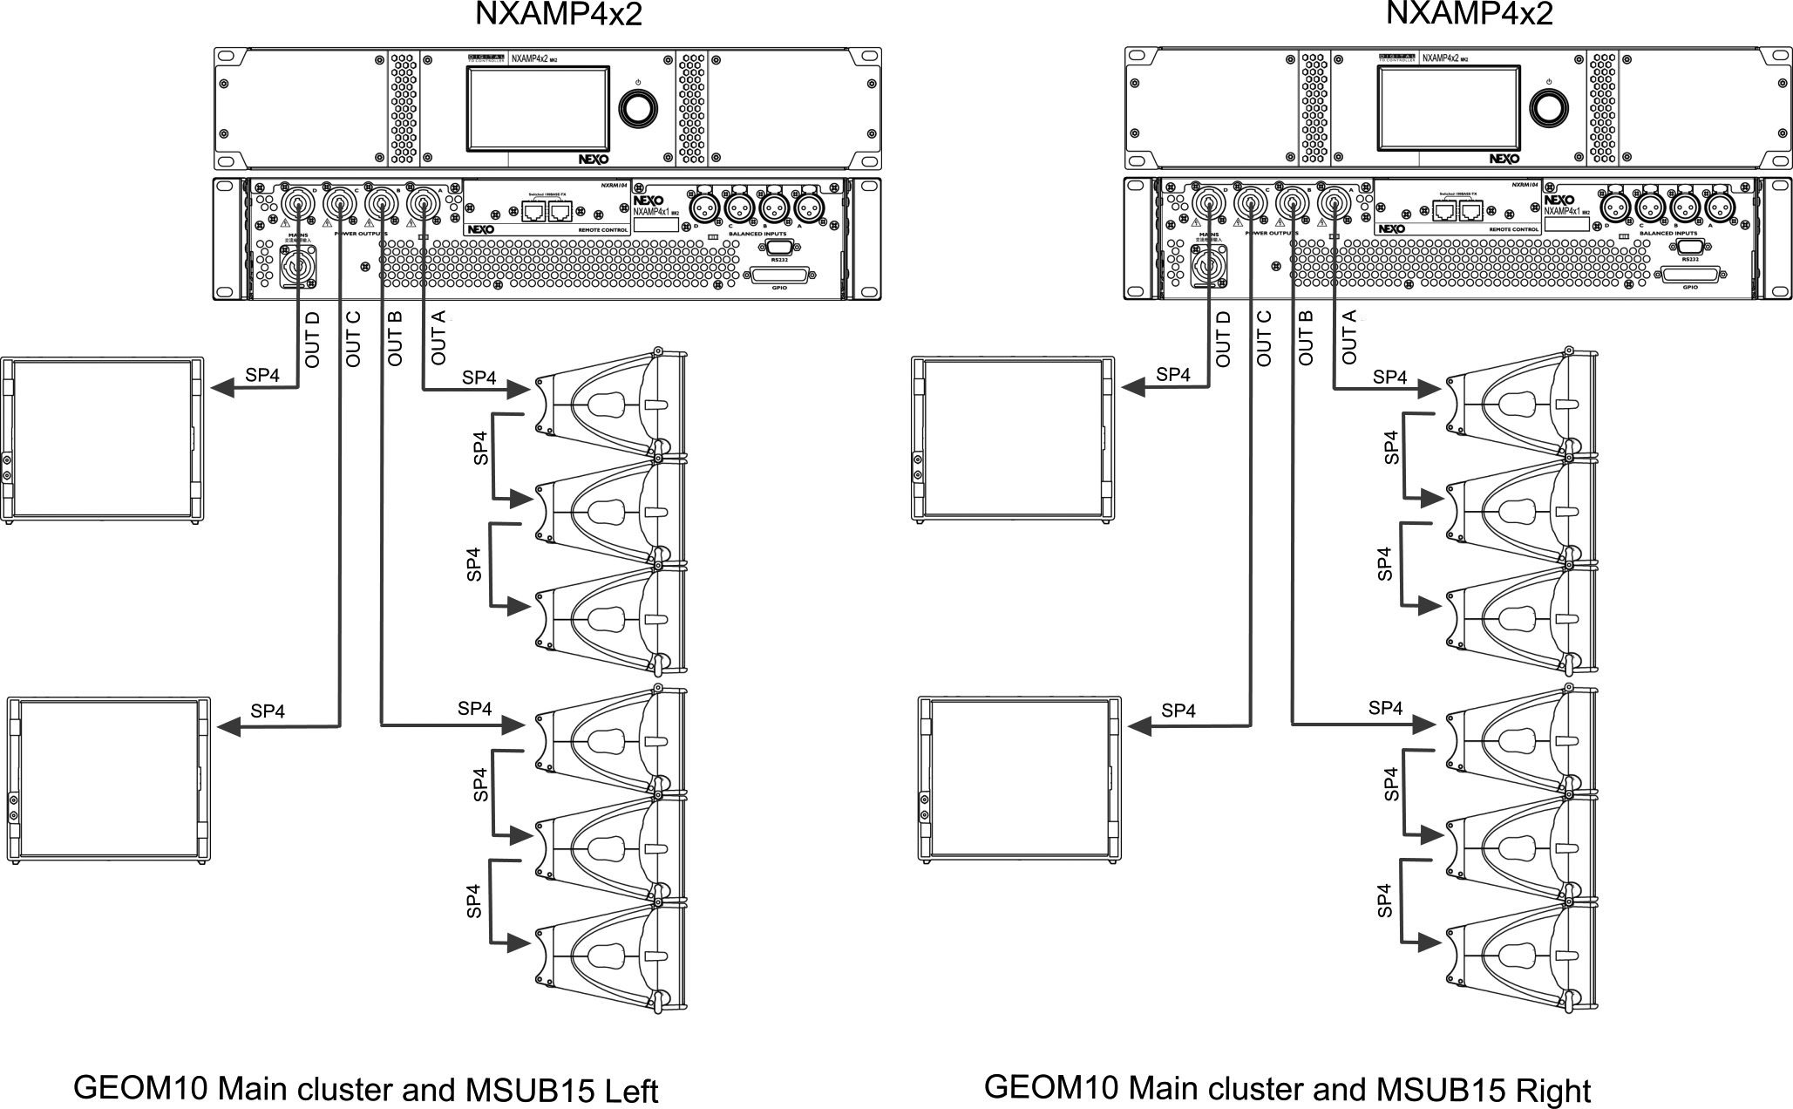
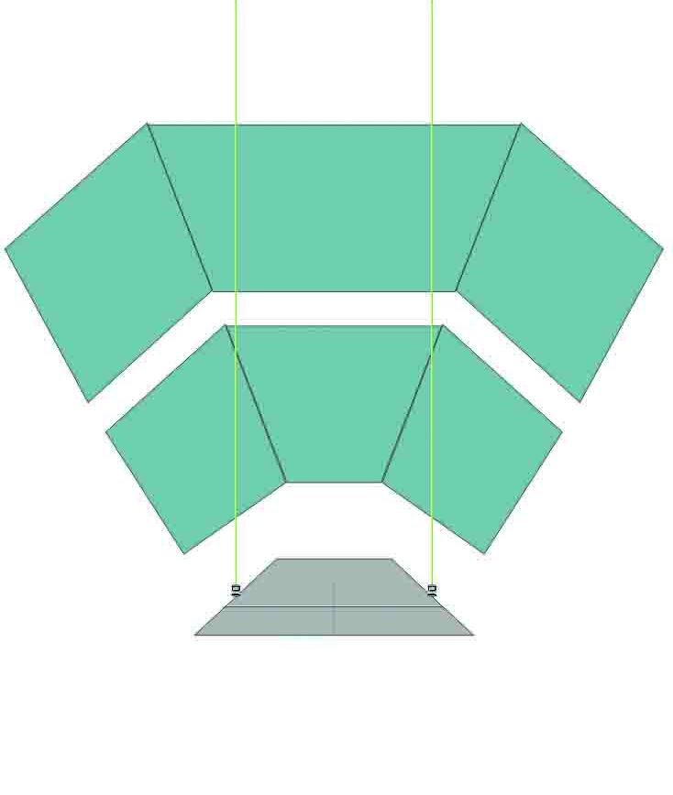
Church top view
Applications

Slide 17
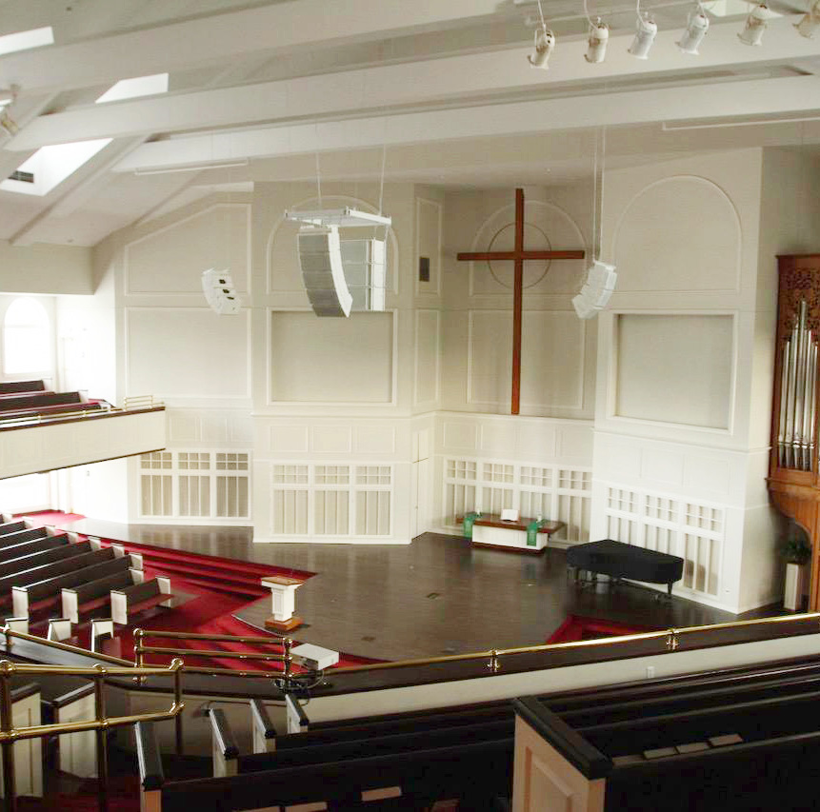
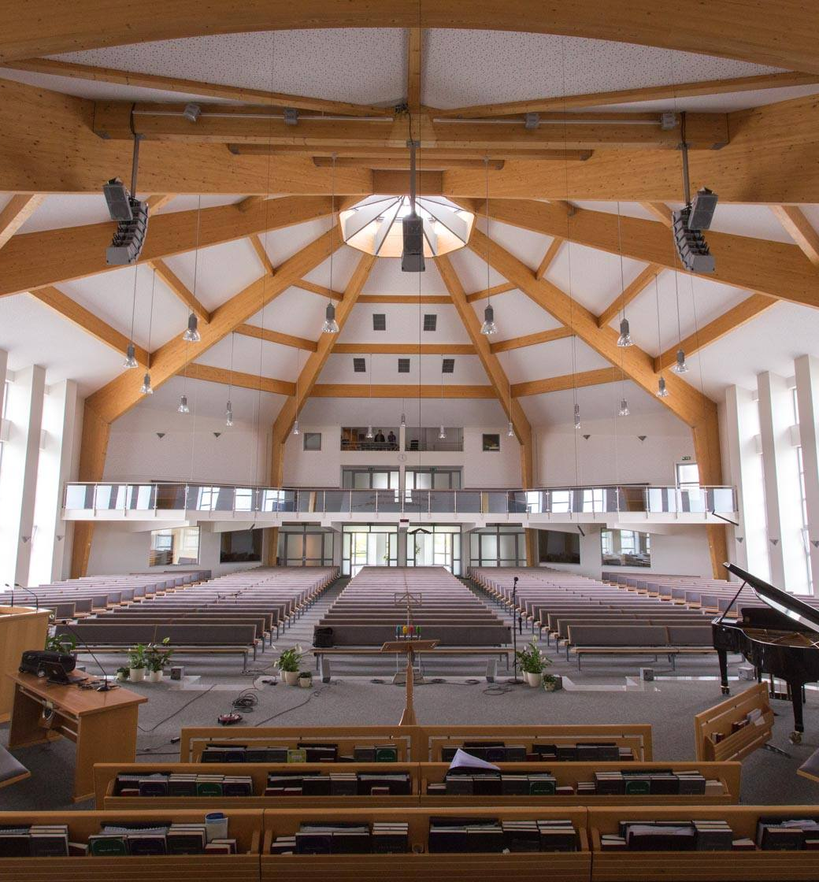
Case Studies
Creative Worship, USA
NEXO GEO S12 line arrays with GEO M6 front fills and PS Series under-balcony fills meet strict design criteria in this American church.
Willebadessn’s Baptist Church, Germany
GEO M6 line arrays complement the calm and elegant interior of this 1500-seat church, delivering smooth and even coverage to the whole congregation.

Slide 18
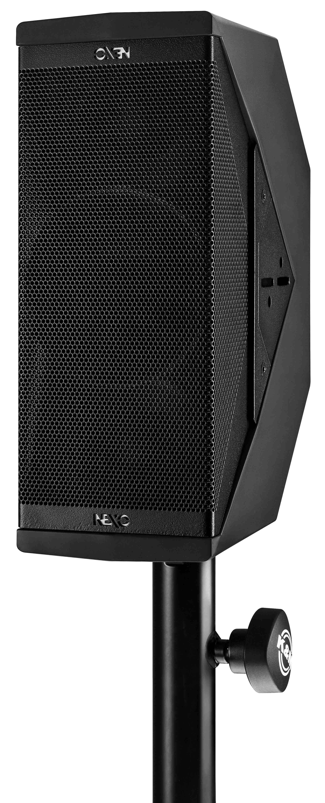
Corporate & Public Spaces
Precision sound, heard but not seen
ID Series
PS Series
GEO M6
GEO M10
NEXO’s most compact speaker gives installers a full range box they can install horizontally or vertically with minimal visual impact.
Setting the standard for high-output, compact loudspeakers, PS Series cabinets are installed in countless public spaces.
NEXO’s most compact line array box harnesses patented technologies to deliver high-quality sound in a visually unobtrusive form factor.
Compact, light in weight and with extended LF response down to 59Hz, GEO M10 makes for a potent yet visually unobtrusive sound system in public spaces.

Slide 19
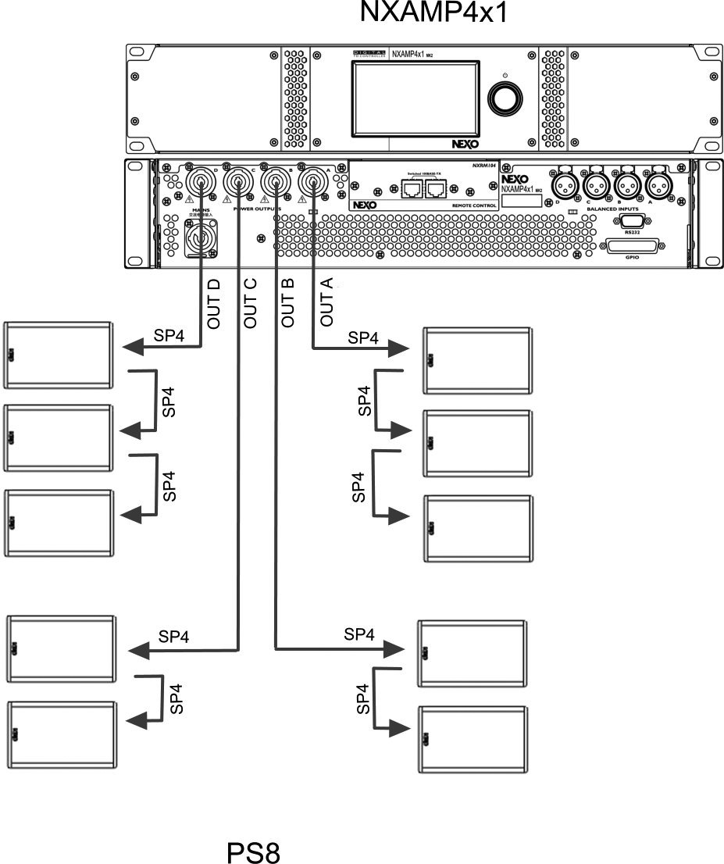
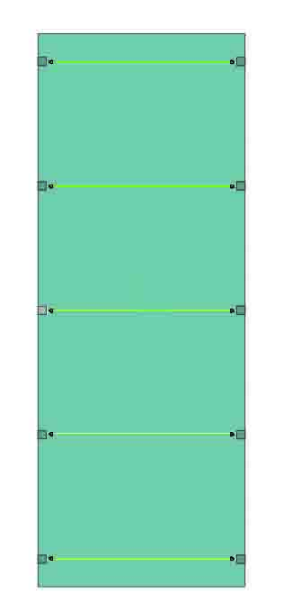
Corporate top view
Applications

Slide 20
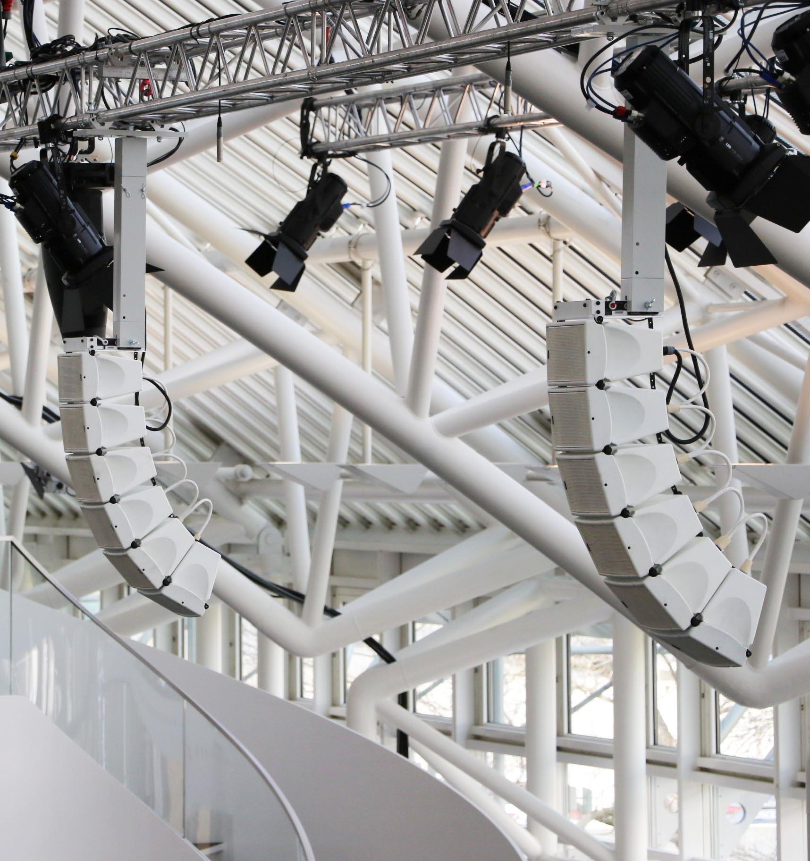
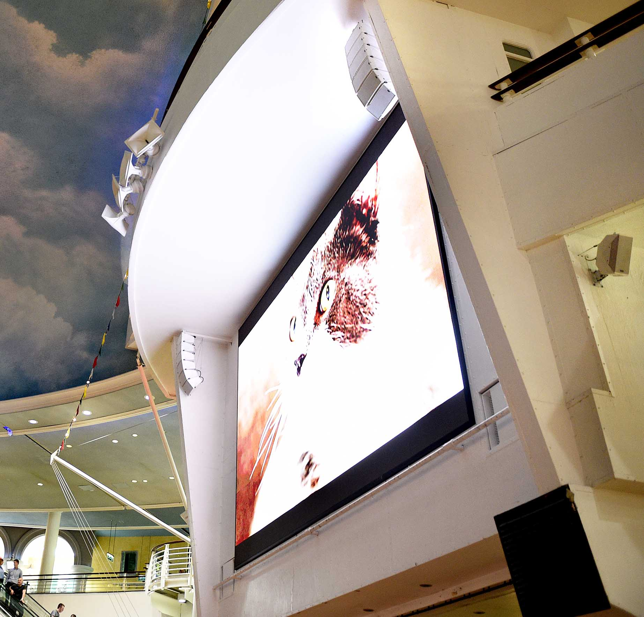
Case Studies
Audi HQ, Germany
Arrays of GEO M6 in the press centre theatre at Audi’s HQ in Ingolstadt.
Trafford Centre, UK
Large and reverberant space. The primary system is a NEXO GEO M6 compact line array, with 6-box hangs of white cabinets. In addition, 8 pairs of ID24 cabinets have been installed around the large atrium.

Slide 21
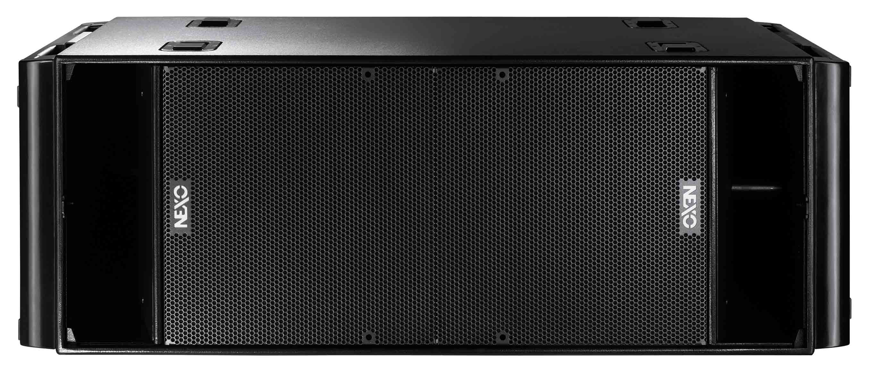
Sports Arenas
Pitch perfect sound
GEO S12-ST
ID Series
STM
RS Subs
Designed for stadium sound installations, NEXO has created dedicated long-throw ST versions of its standard GEOS1210-30, delivering the highest audio quality standards.
NEXO’s ultra-compact and visually unobtrusive ID24 cabinets are ideal for use in VIP areas and corporate boxes.
Comprising Main, Bass, Sub and Omni modules, STM combines with plug and play networkable powering solutions to make configuring and installing the perfect sound system easy for sports arena.
Flown in clusters with GEO S12s or mounted individually in the roof, RS subs bring stunning low frequency performance to a stadium sound system.

Slide 22
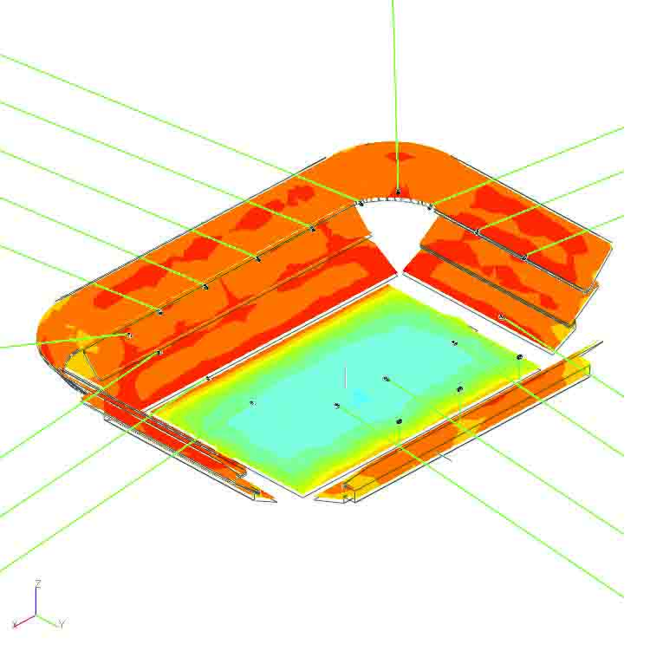
The system was designed using NEXO NS-1 modeling software
(Standard de Liège, Belgium)
Applications

Slide 23
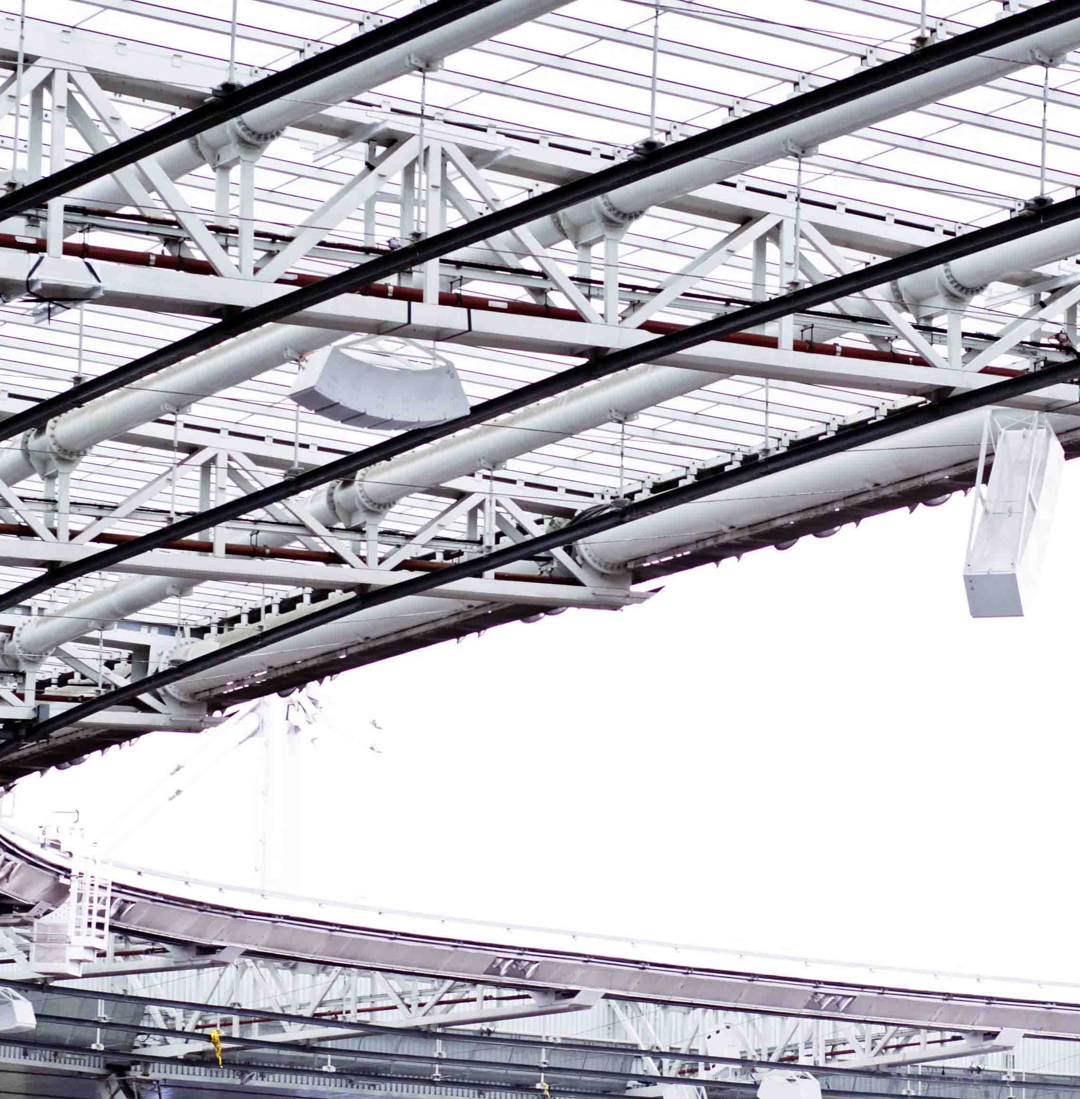
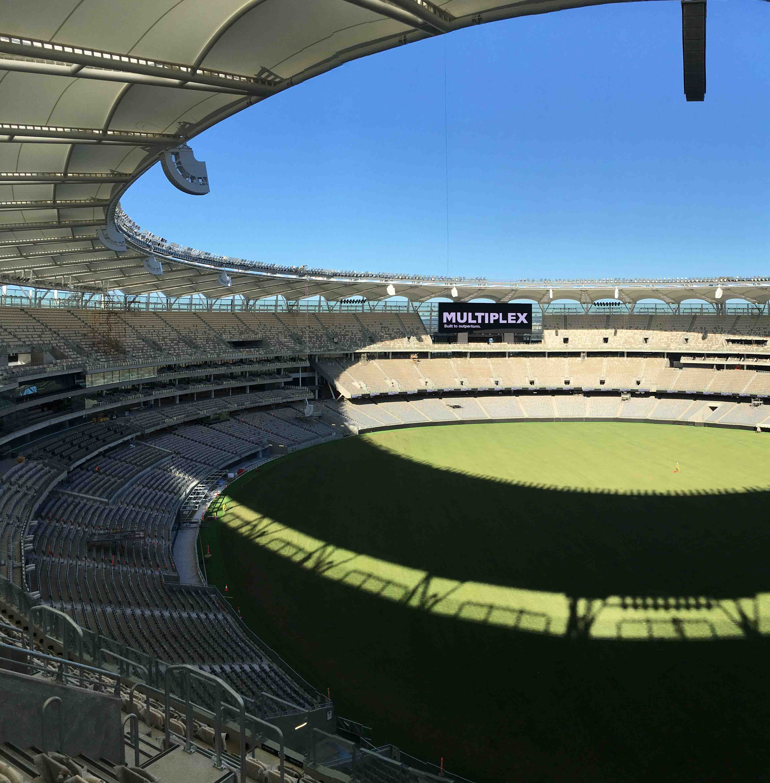
Case Studies
Stade de France
Almost 300 NEXO cabinets are installed in our local sports stadium, the legendary Stade de France!
Perth Stadium, Australia
Nearly 500 NEXO loudspeaker cabinets, line array and point-source, have been installed in the prestigious Optus Stadium in Perth. A 3-year design process included extensive evaluation of loudspeaker systems.

Slide 24
